Slide 1
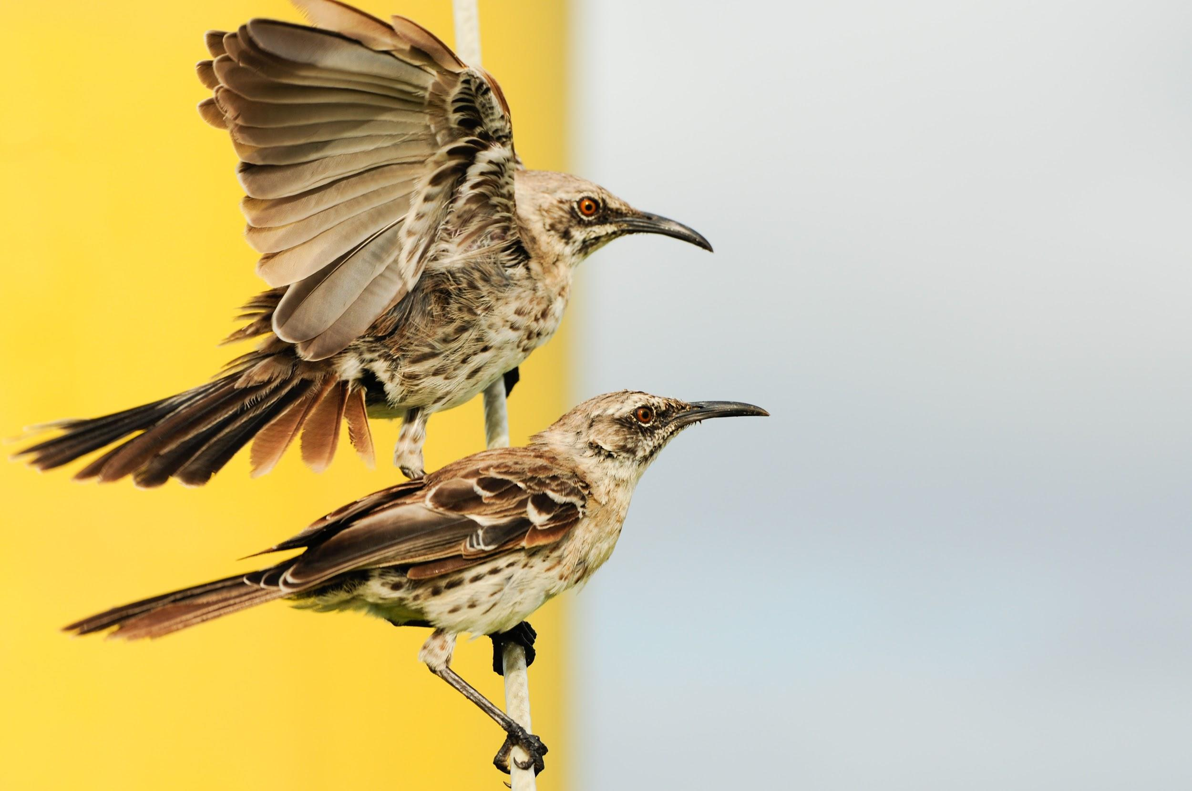
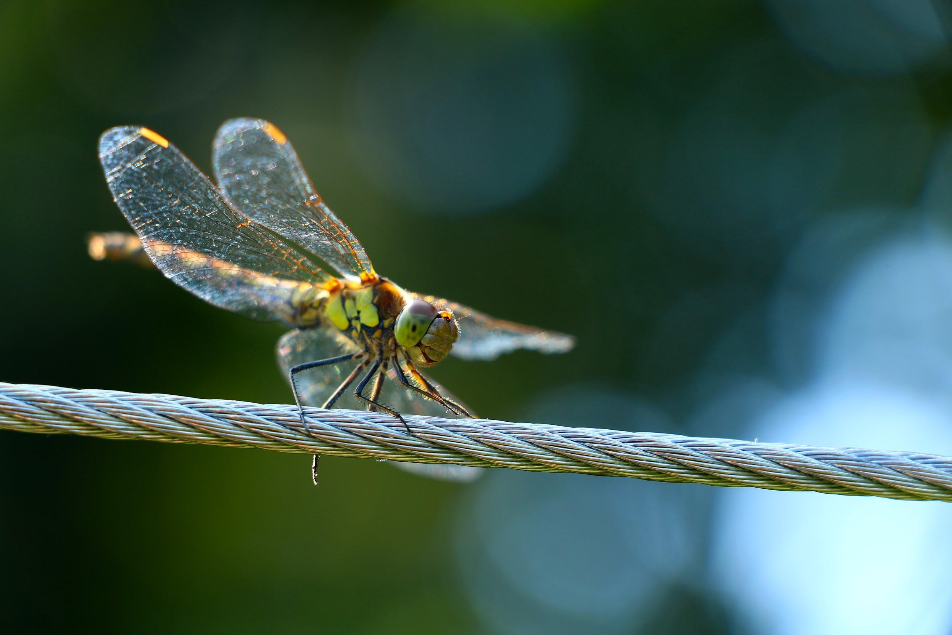
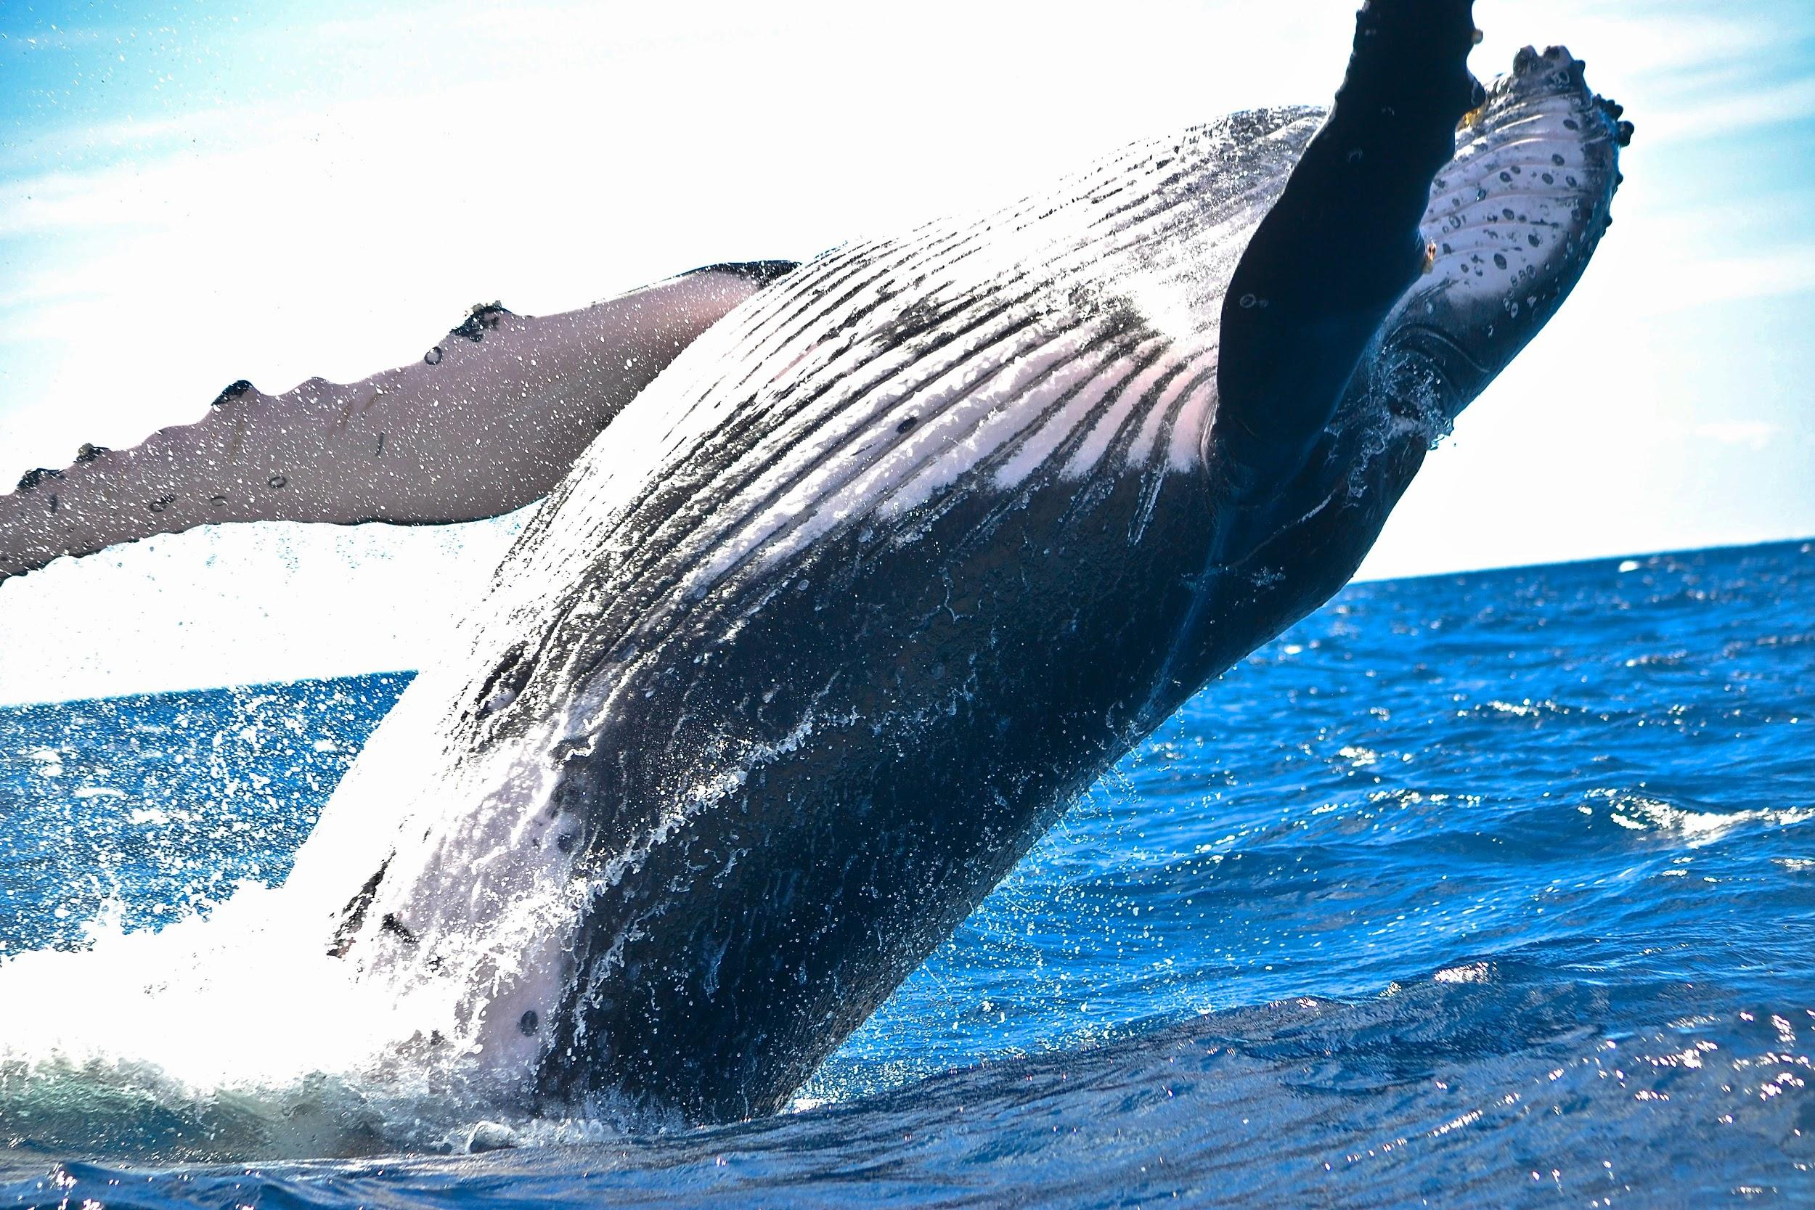
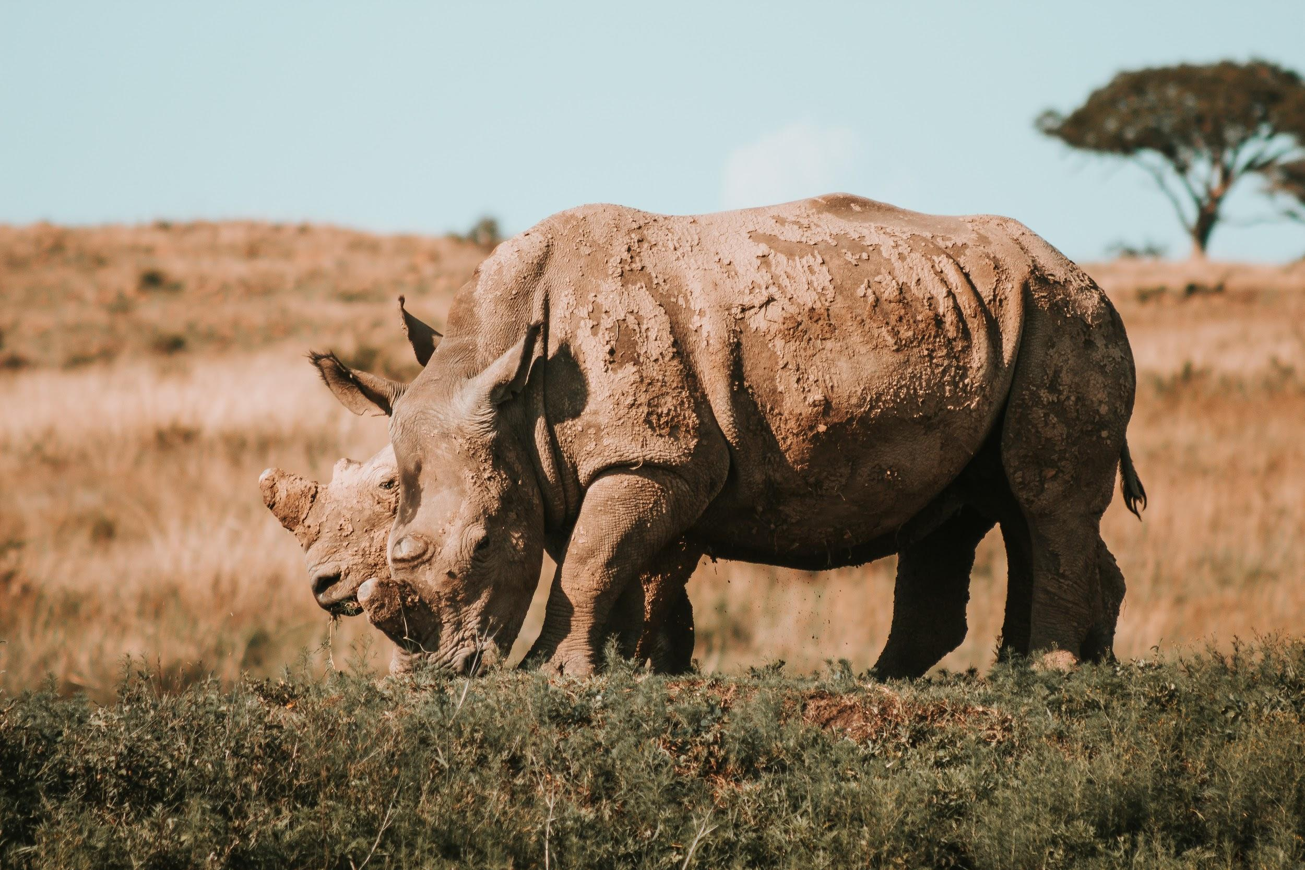
TABULAR KEYS
We will classify organisms using tabular keys
Notes:
Insert cover image and use transparency settings to fade image.

Slide 2
Do not delete this slide.
This slide is designed so that you can copy the prompt box you need and insert it into your slides.
This slide is hidden and will not be included when presenting your lesson.
TRACK WITH ME
VOCABULARY
1 -
HINT
Students, remember….
CHECK FOR UNDERSTANDING
READ WITH ME
TEACHER CUE
MAKE THE CONNECTION
Students, you already know….
EXTENSION

Slide 3



A group of individuals conducted an experiment to see what raises a person's heart rate more; sprinting or walking. The averages are recorded below.
What caused people’s heart rate to increase more?
What controlled variables are needed in this experiment?
Exercise | Average Heart Rate (bpm)
Sprinting | 163
Walking | 114

Slide 4
Repeat the opposite word/phrase.
CLASSIFICATION SYSTEM
GROUPS WITH SIMILAR QUALITIES

Slide 5
Repeat the opposite word/phrase.
DICHOTOMOUS KEY
SPLIT INTO TWO

Slide 6

Using the picture below, what are some observations you could make?
Using your observations, what are some inferences you could make? Refer back to your knowledge of forces.

Slide 7

Using the picture below, what are some observations you could make?
Using your observations, what are some inferences you could make? Refer back to your knowledge of forces.

Slide 8
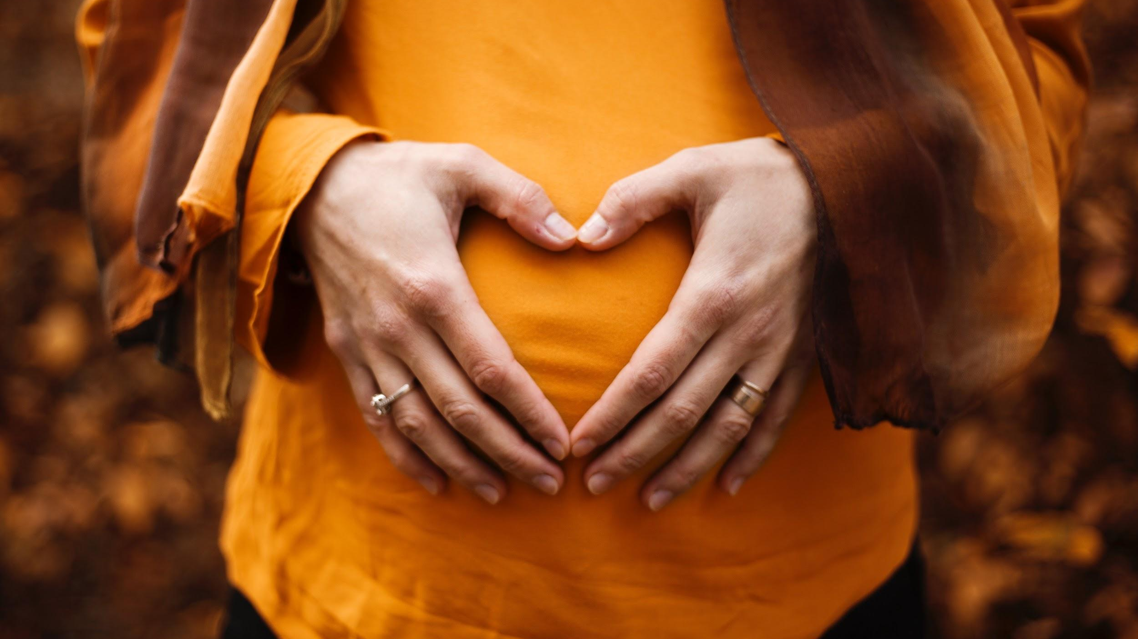
Is this a good scientific model of the heart?
Explain your answer with reference to what makes a good scientific model?

Slide 9
We will classify organisms using tabular keys.
TRACK WITH ME
READ WITH ME
We will define tabular.
We will use provided tabular keys to classify organisms,
We will construct tabular keys.
DECLARE THE OBJECTIVE
Read the learning objective to your partner.
Notes:
Learning Objectives contain concepts (nouns, big ideas), skills (verbs, measurable behaviours) and sometimes context (restricting or targeting conditions).
●Example: Students will be able to describe the concept of density and apply it to floating and sinking.
●
Success criteria are specific measurable outcomes that if met mean that the student has met the learning objective.
Examples:
•Students will be able to compare densities of substances using mass and volume.
•Students will be able to identify whether a solid or liquid will float or sink in a liquid based on their densities.

Slide 10
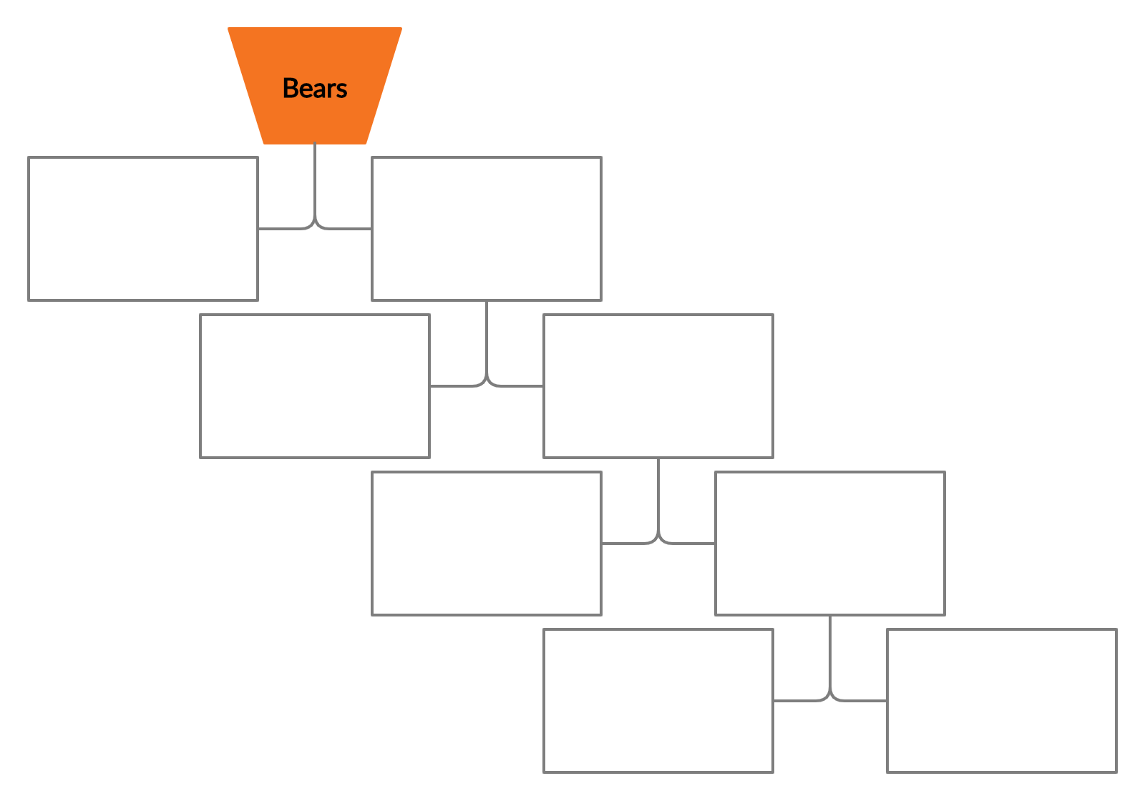

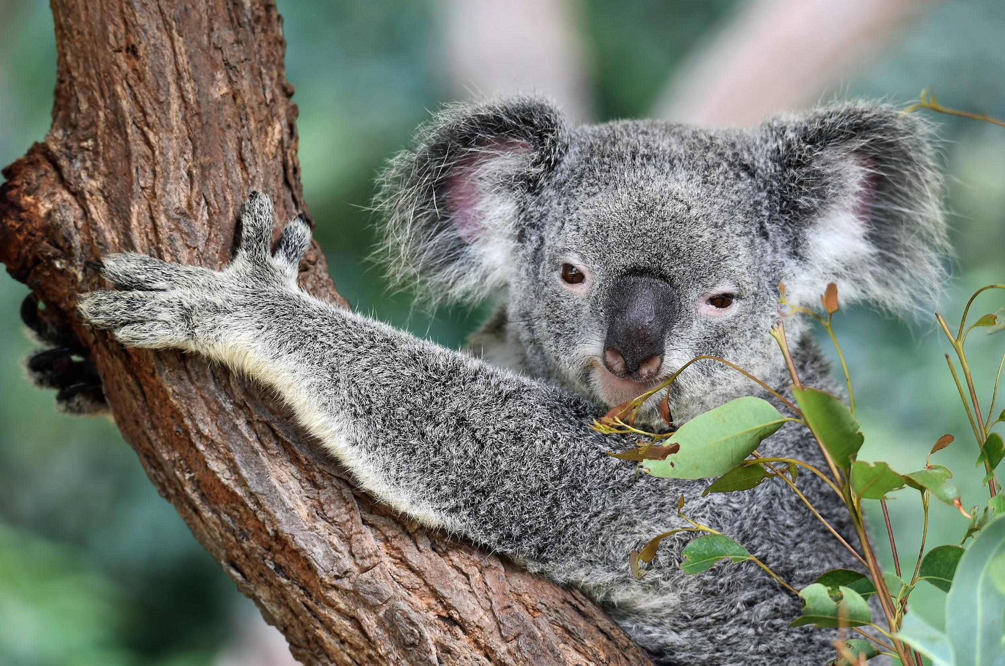
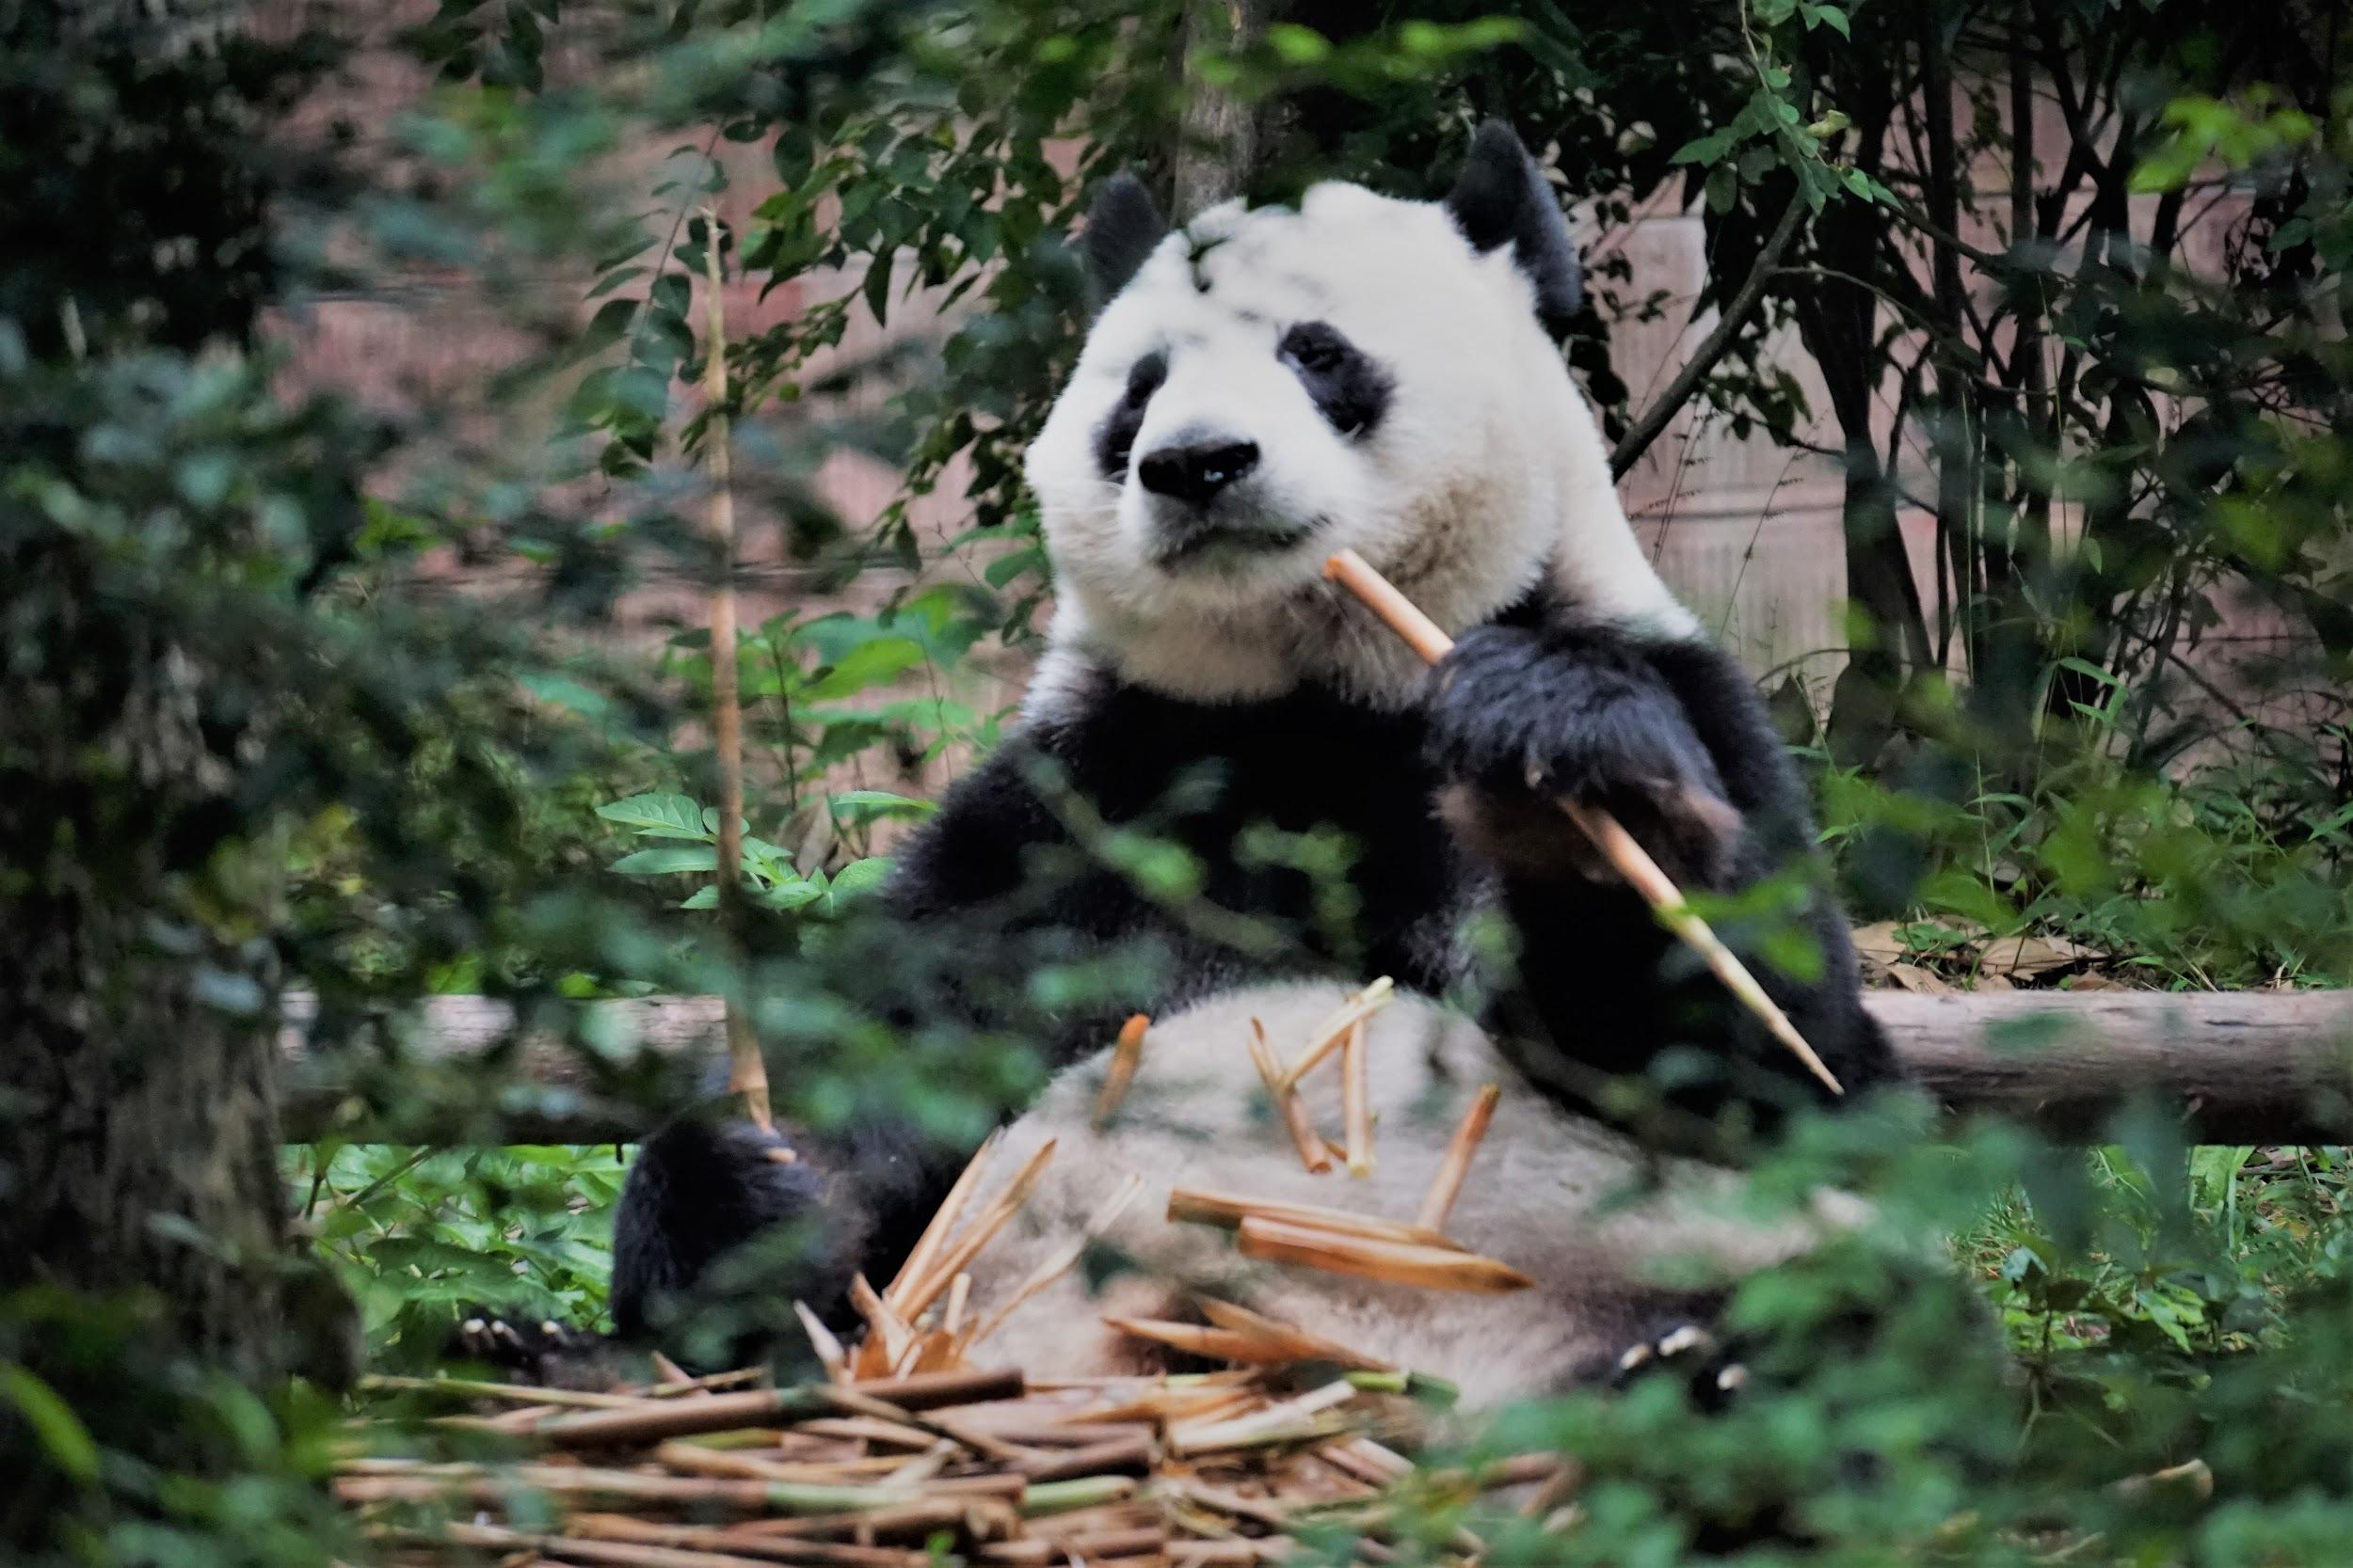
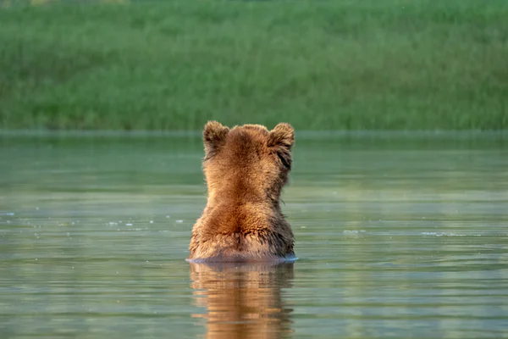
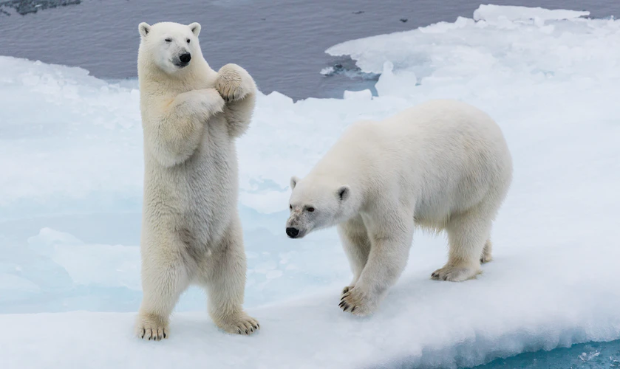
We will classify organisms using tabular keys.
Classification systems are used in Science to separate a large group of organisms₁ into smaller sub-groups.
A dichotomous key separates organisms based on simple yes or no decisions (e.g. has claws).
Create some yes or no decisions to classify the different types of bears.
VOCABULARY
1 - any living thing

Slide 11
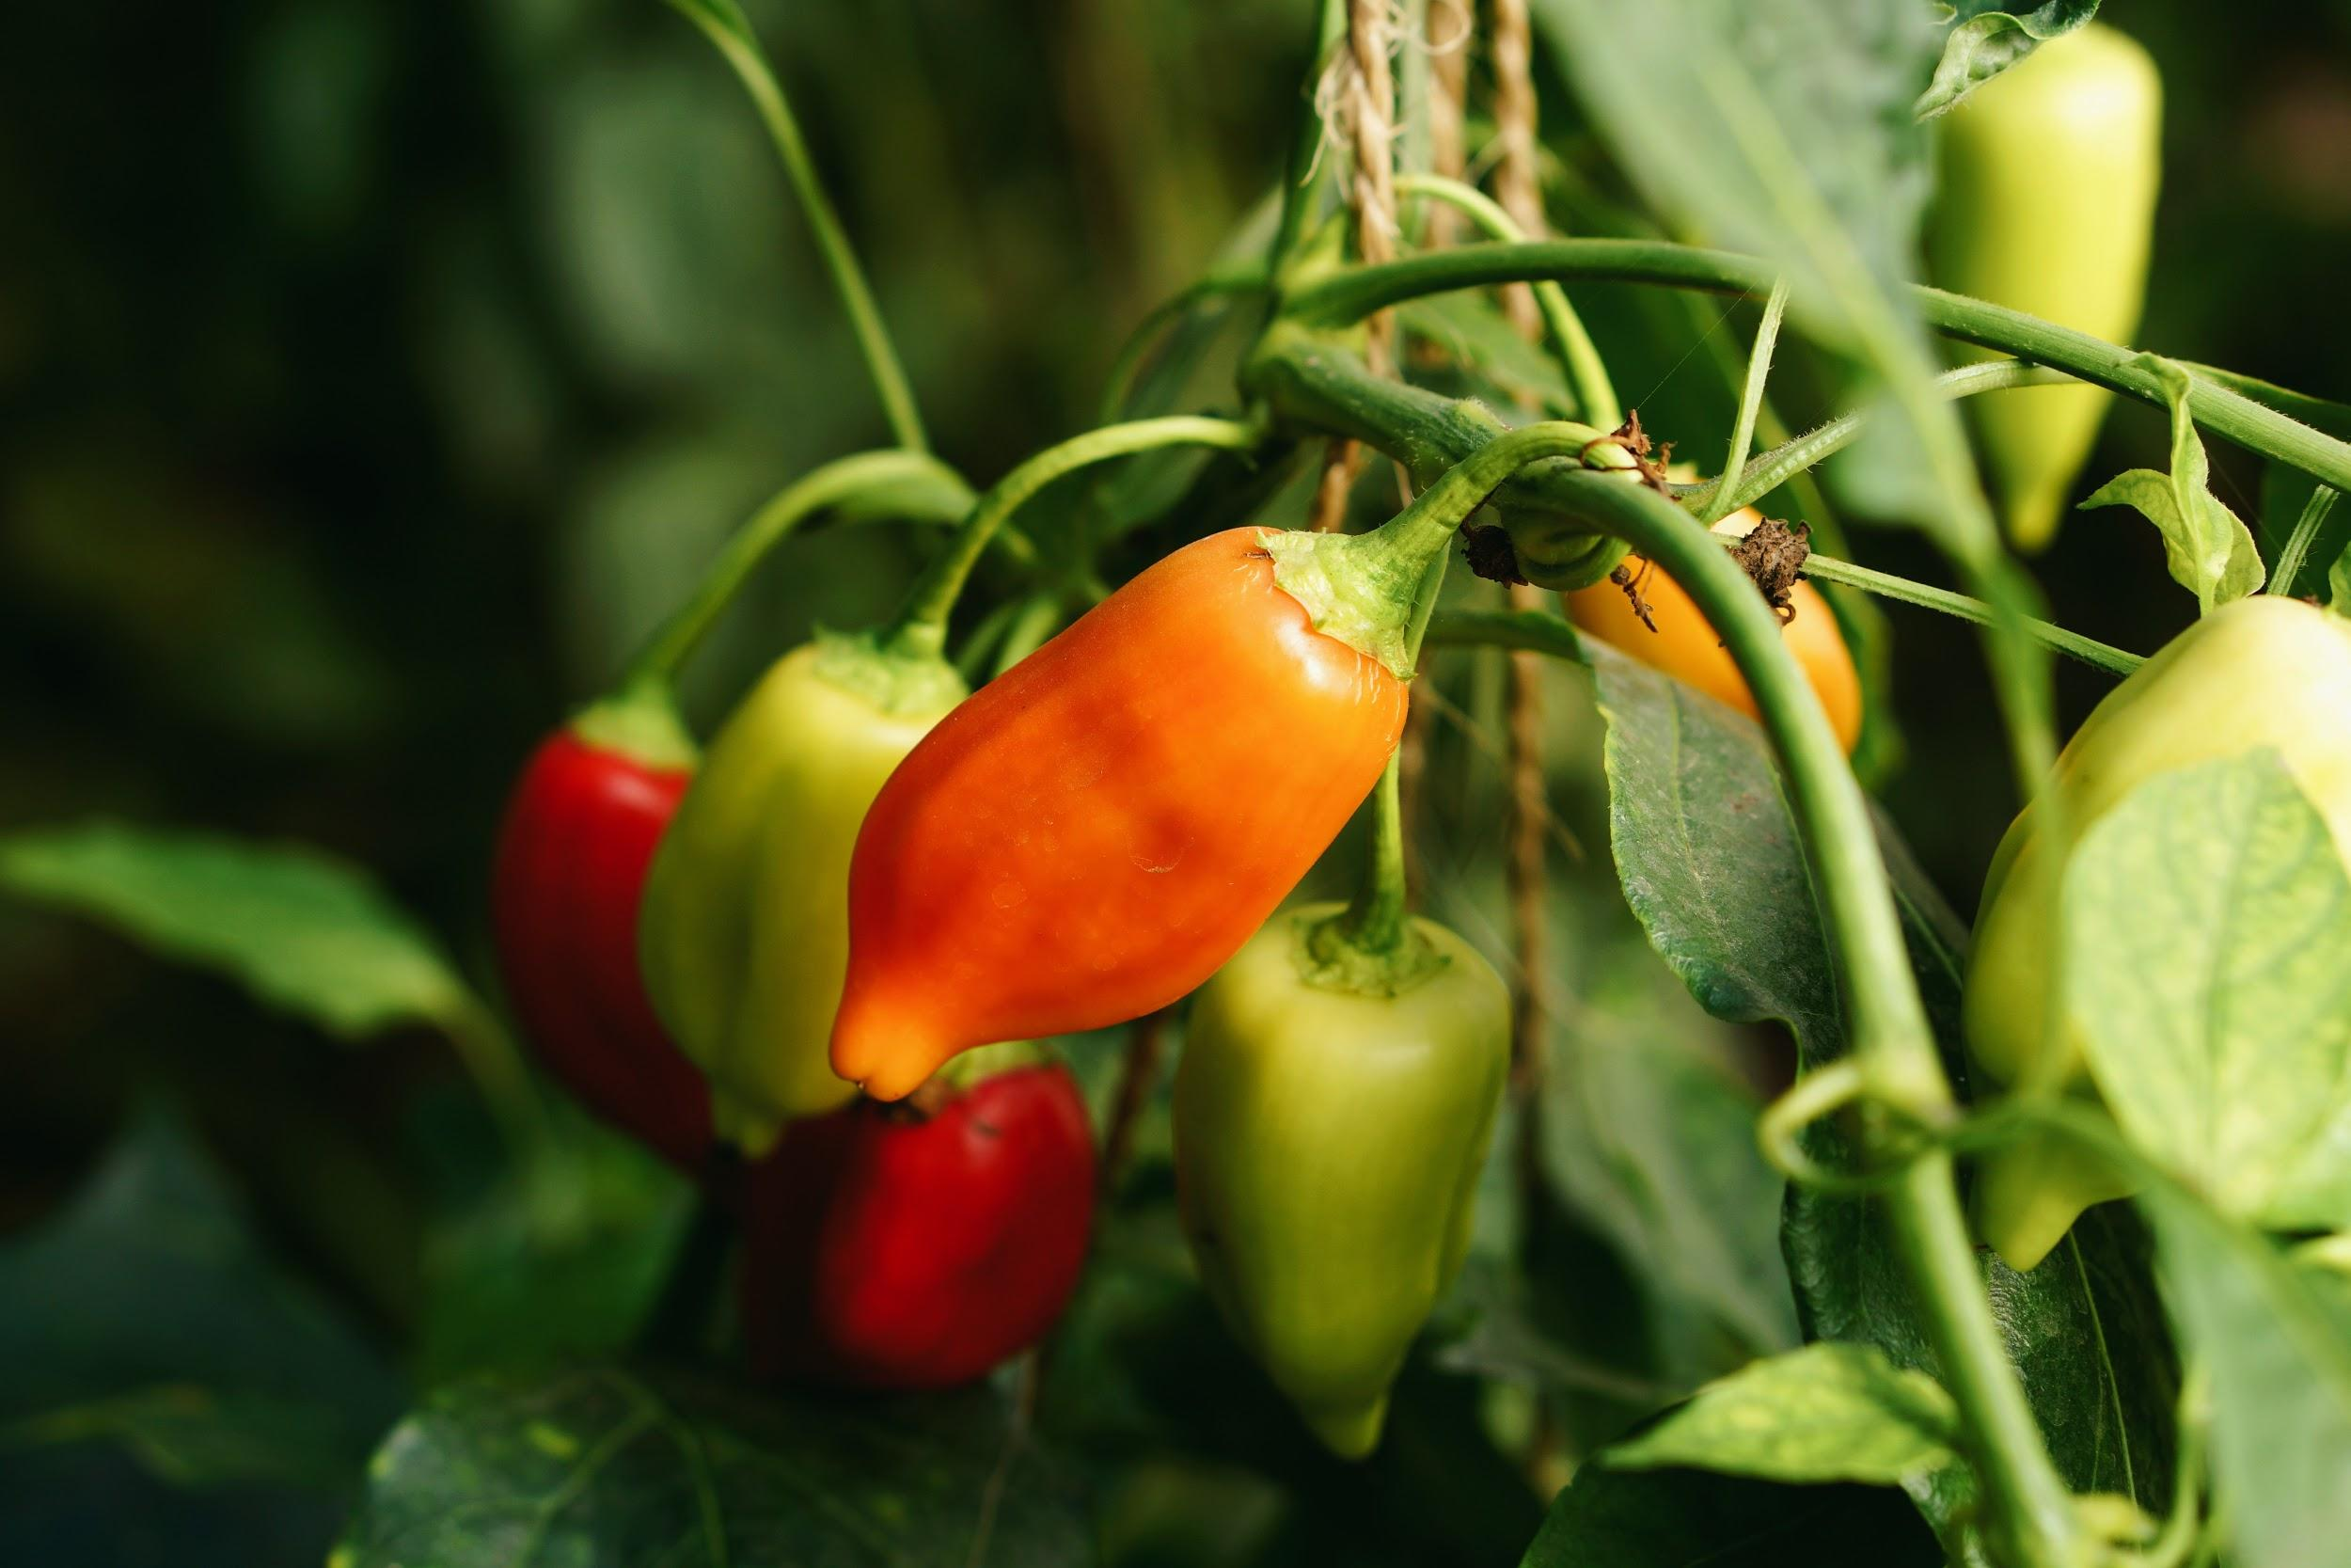
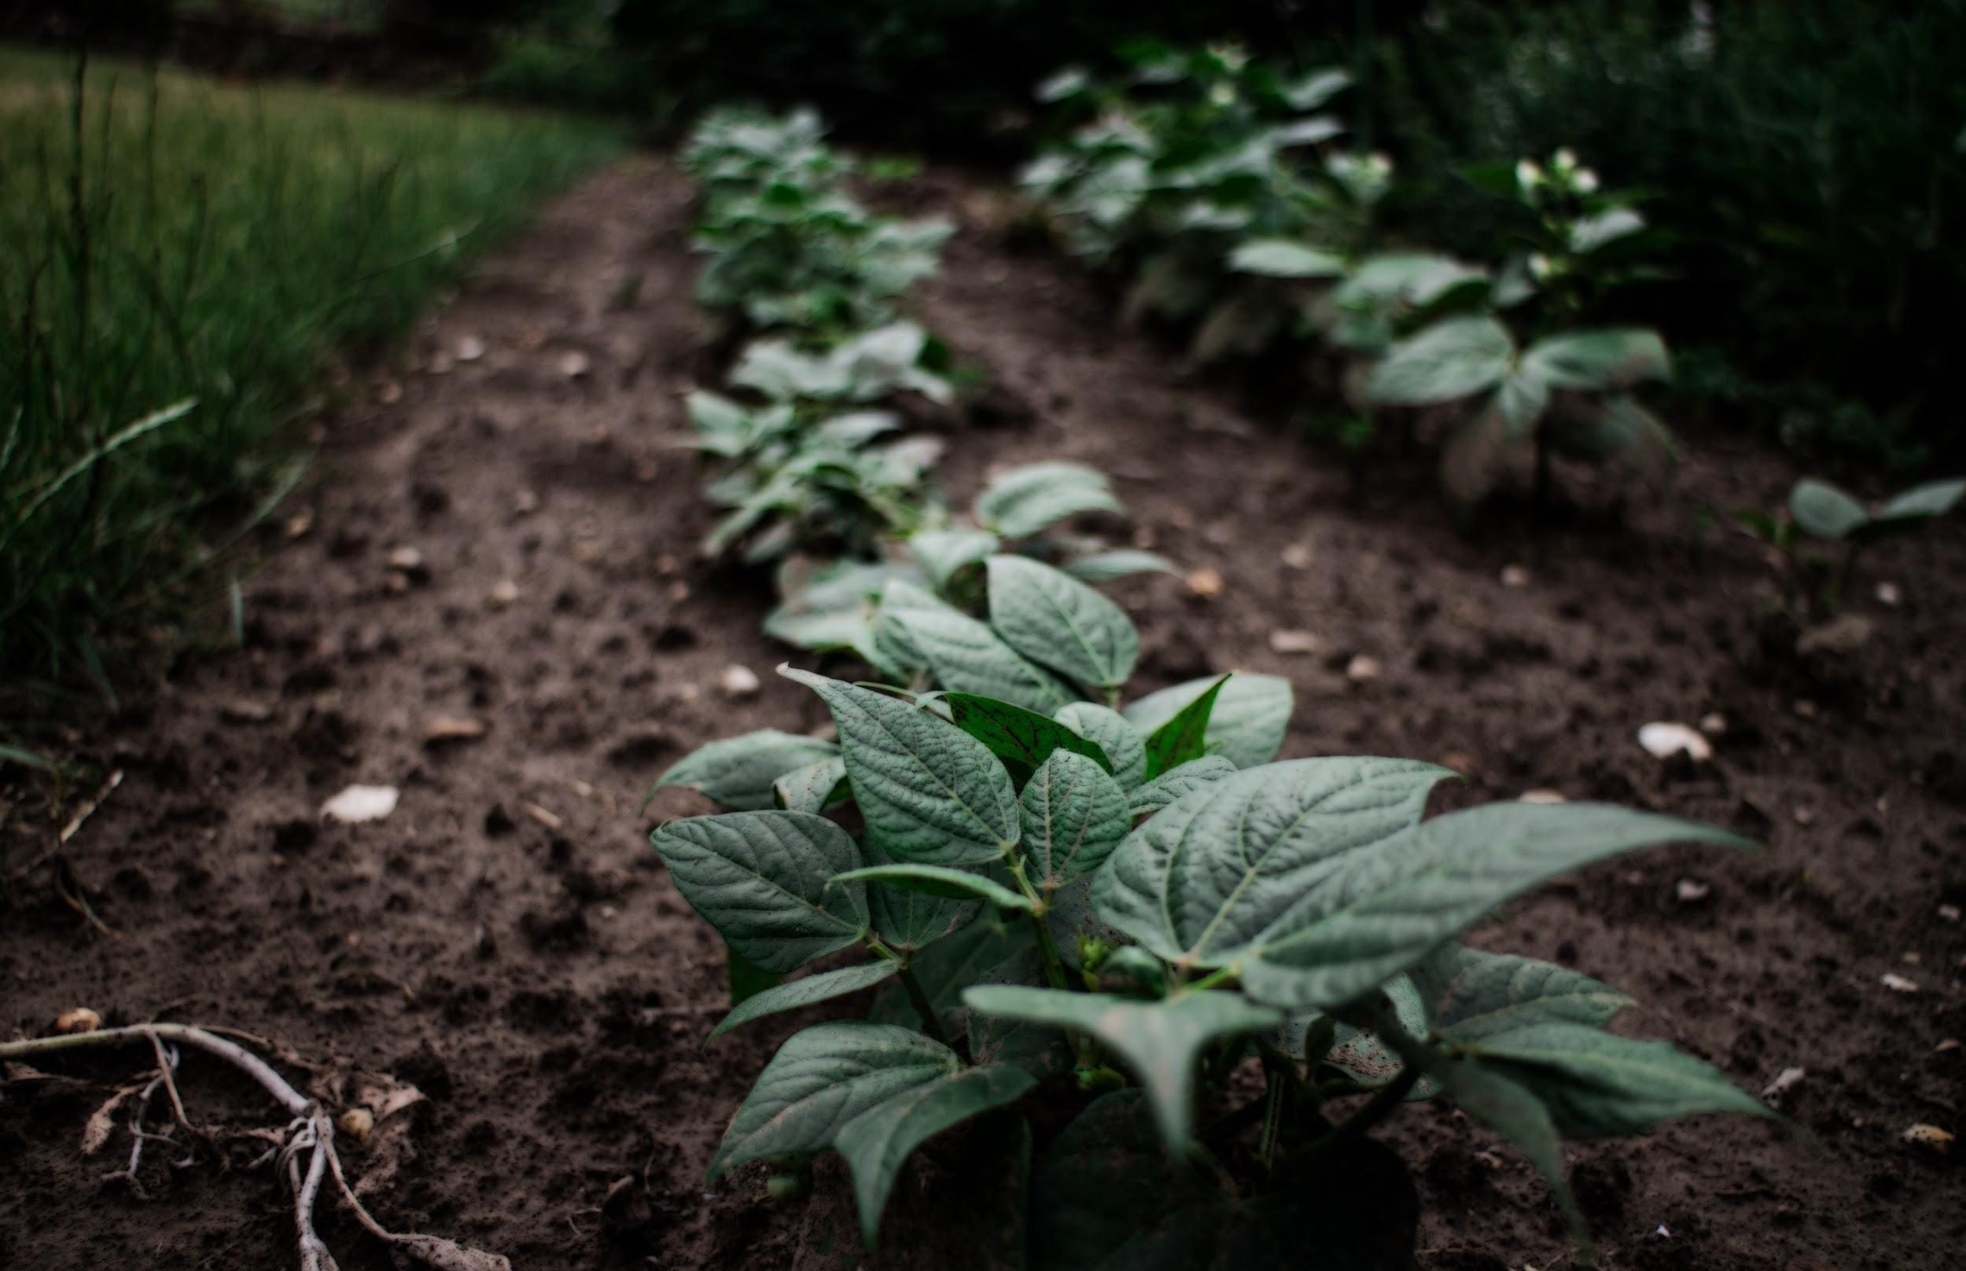
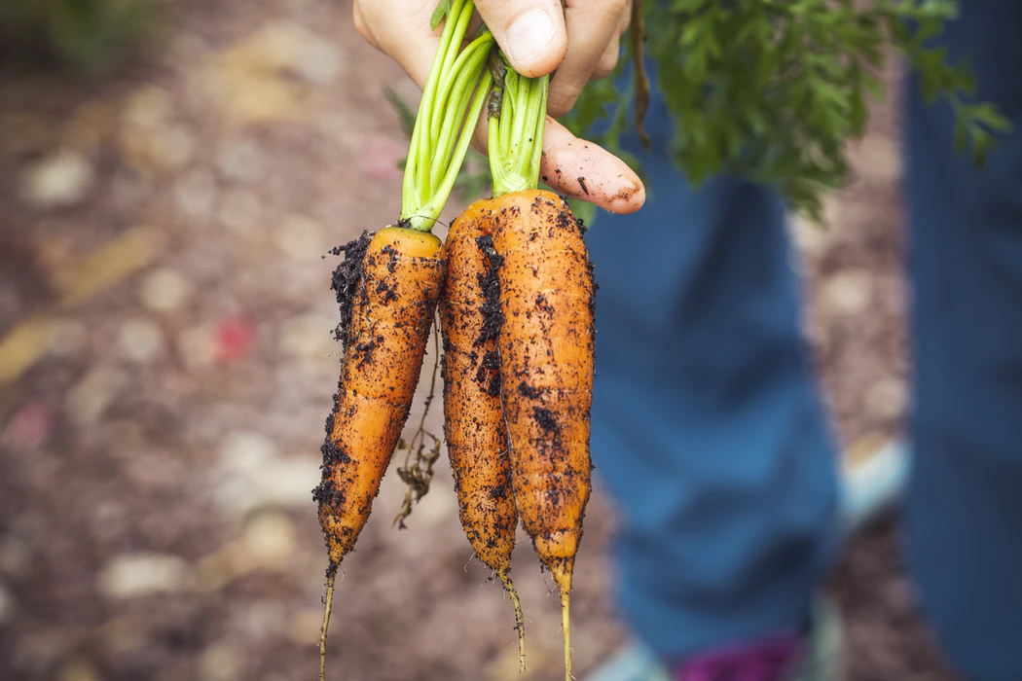
We will classify organisms using tabular keys.
A classification system is a way of separating a large group of closely related organisms into smaller subgroups.
Scientists use classification keys as visual representations₁ to highlight the differences between organisms.
CHECK FOR UNDERSTANDING
Why do we use classification systems? Explain.
VOCABULARY
1 - diagrams and charts

Slide 12
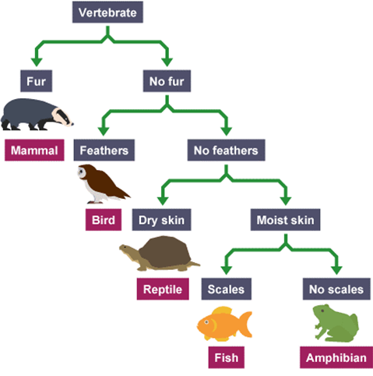
We will classify organisms using tabular keys.
CHECK FOR UNDERSTANDING
What do the question marks represent in the table below?
Tabular keys are used to compare different organisms₁ and separate them based on specific qualities. Tabular keys are often used when a branching key is too cluttered and confusing.
1 | Fur No Fur | Mammal Go to 2
2 | Feathers No Feathers | Bird Go to 3
3 | Dry Skin No Dry Skin | Reptile Go to 4
4 | Scales No Scales | ? ?
Like dichotomous keys, tabular keys offer two choices at each stage, where a decision is made until every organism is classified.
VOCABULARY
1 - living organisms

Slide 13
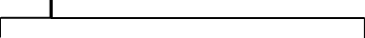
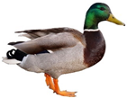
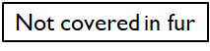
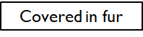
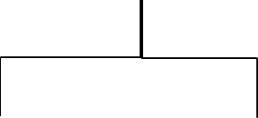
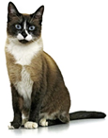
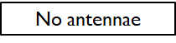
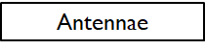
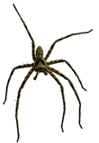
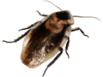
We will classify organisms using tabular keys.
Small tabular keys are easy to construct when using a dichotomous key.
1 | Feathers No feathers | Duck Go To 2

Slide 14
We will classify organisms using tabular keys.
Small tabular keys are easy to construct when using a dichotomous key.
1 | Feathers No feathers | Duck Go to 2
2 | Covered in fur Not covered in fur | Cat Go to 3

Slide 15
We will classify organisms using tabular keys.
Small tabular keys are easy to construct when using a dichotomous key.
1 | Feathers No feathers | Duck Go to 2
2 | Covered in fur Not covered in fur | Cat Go to 3
3 | Antennae No antennae | Cockroach Spider

Slide 16
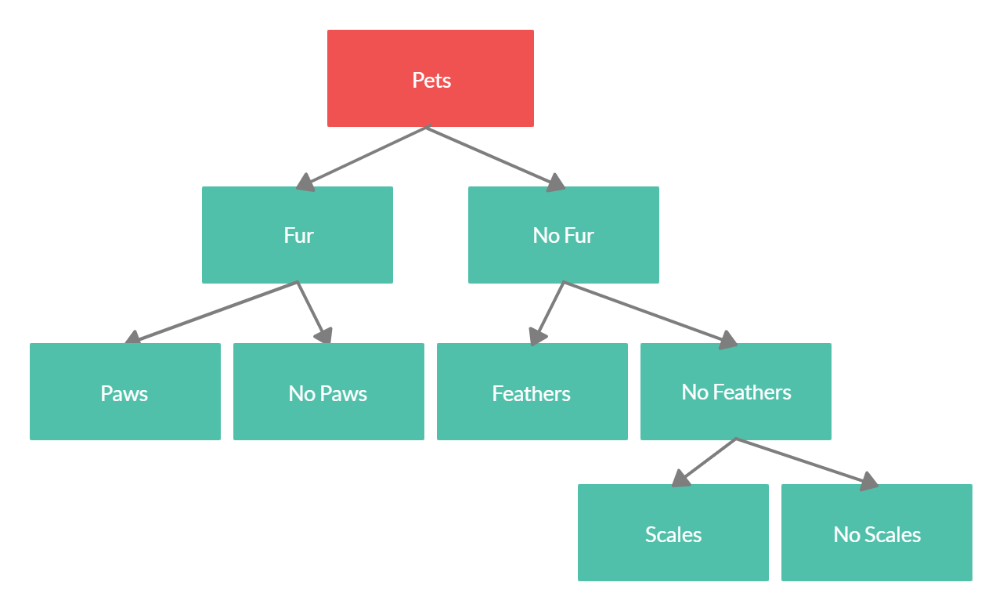
We will classify organisms using tabular keys.
CHECK FOR UNDERSTANDING
Using the table below, identify the following animals: Ferret - Bird - Snake Dog - Frog
Tabular keys are useful for simplifying complex dichotomous keys. Tabular keys can be used to identify different animals based on observable features.
1 | Has Fur Has No Fur | Go to 2 Go To 3
2 | Has Paws Has No _______ | ________ ________
3 | Has __________ Has No _______ | ________ Go to 4
4 | Has __________ Has No _______ | ________ ________

Slide 17
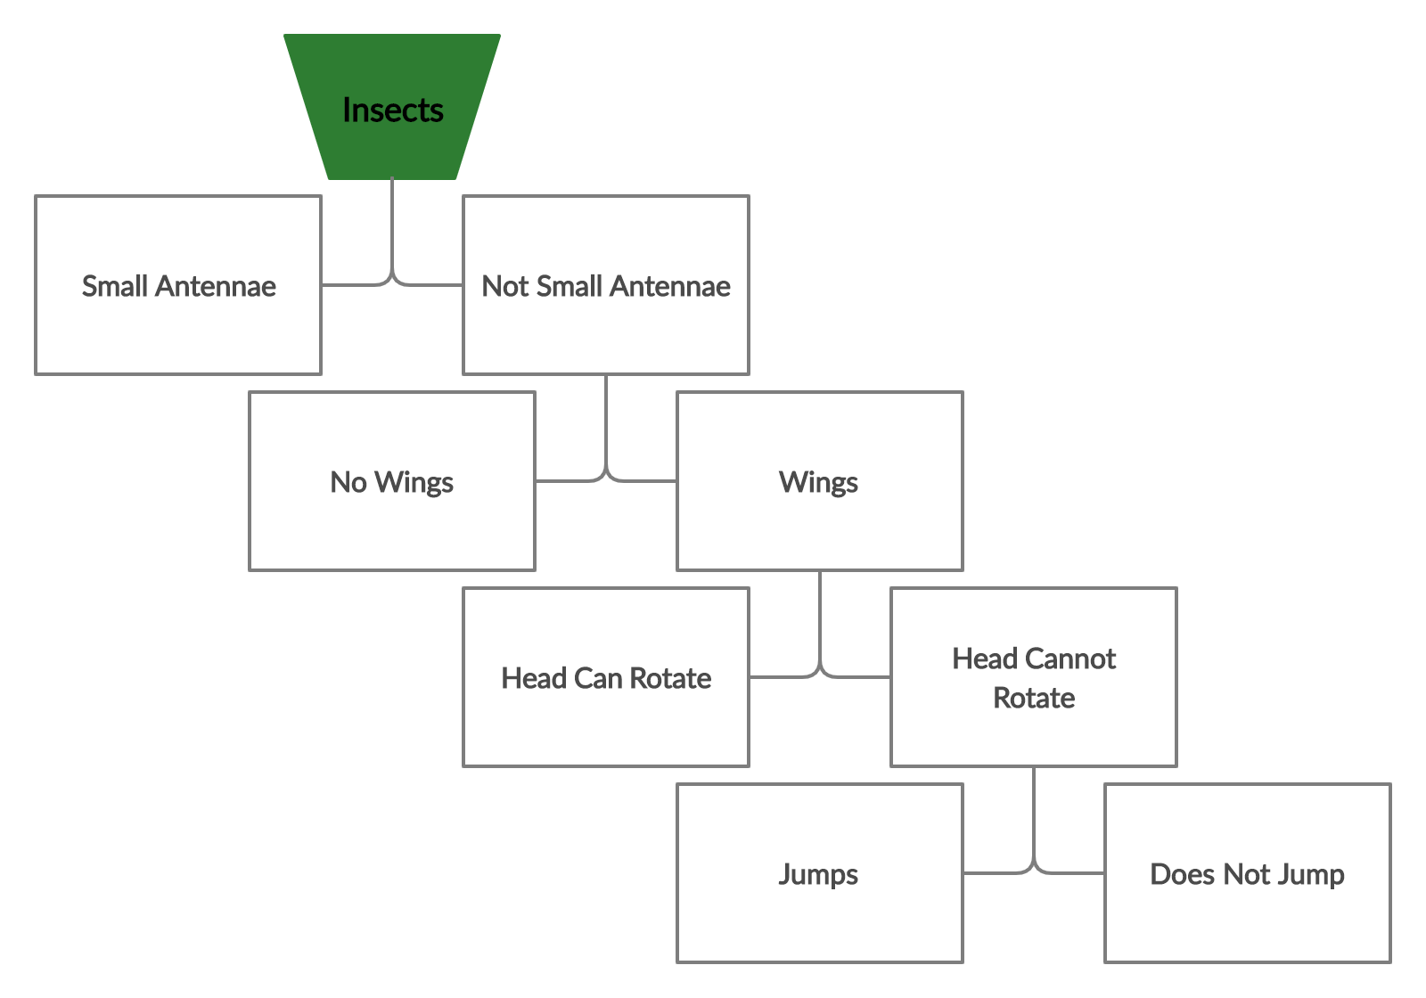
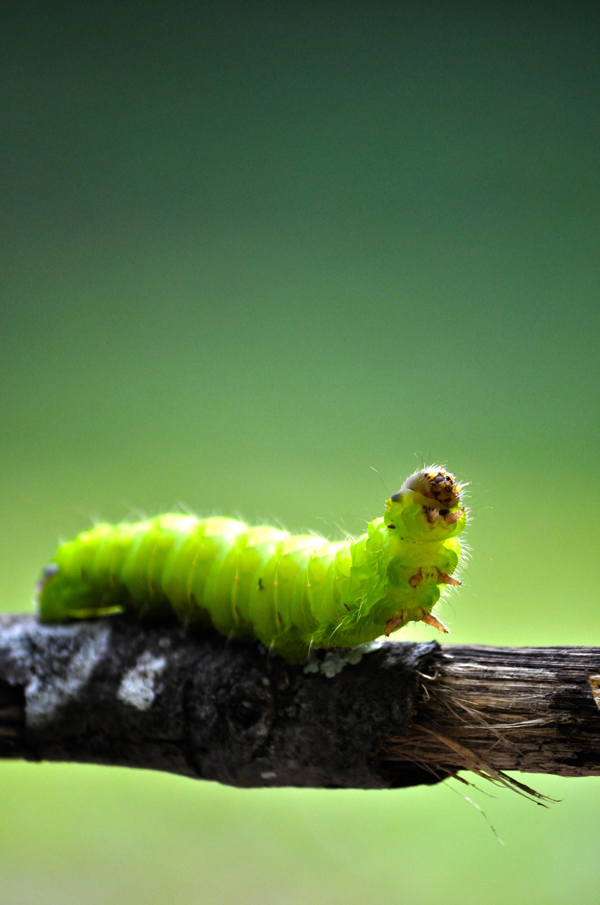
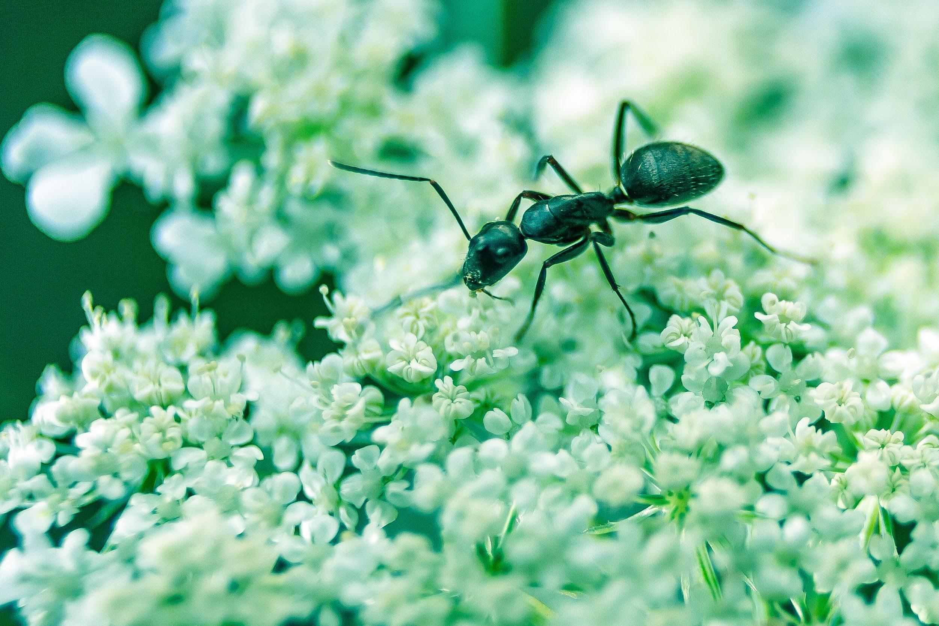
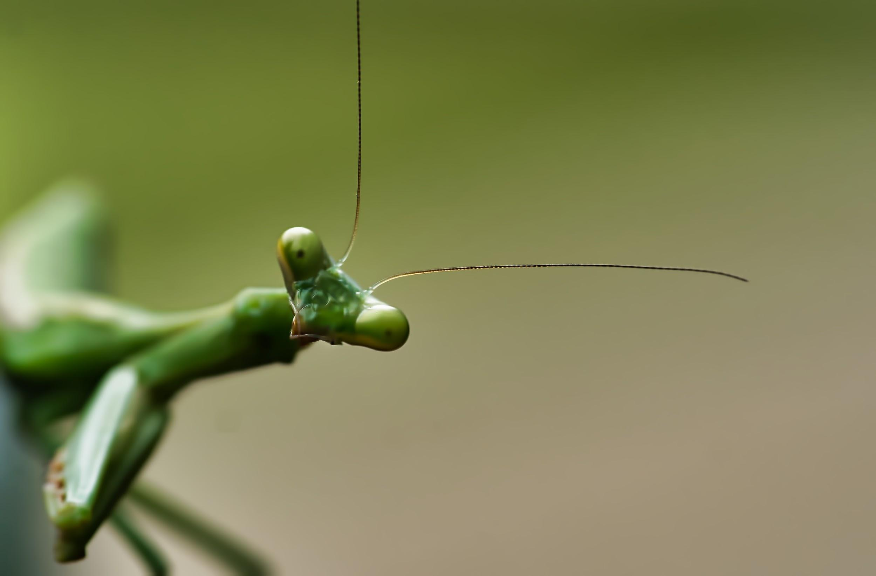
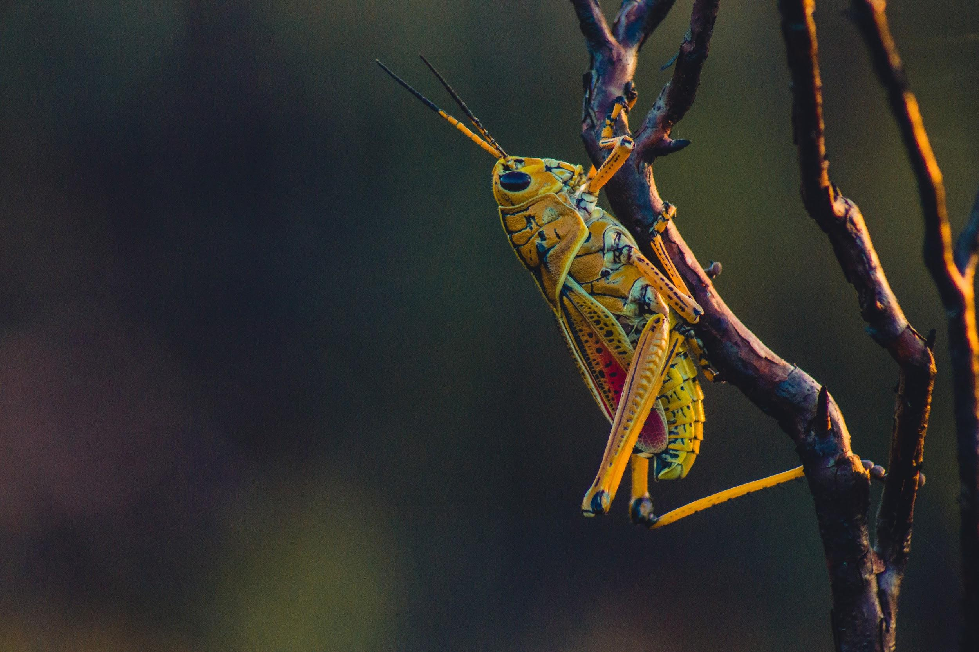
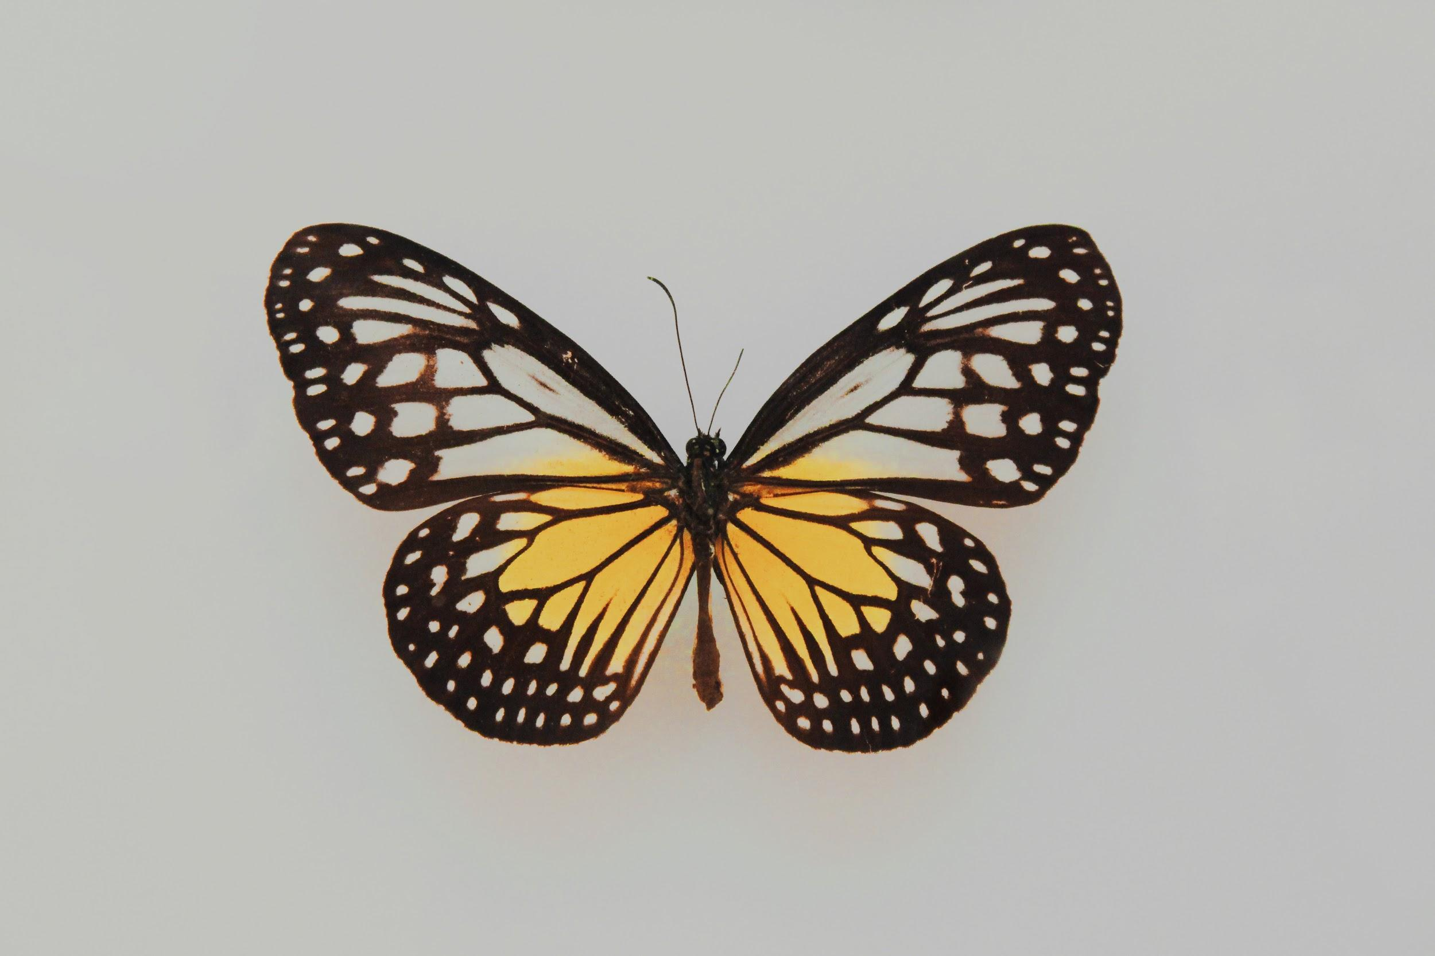
We will classify organisms using tabular keys.
CHECK FOR UNDERSTANDING
Use the table below to identify: Caterpillar - Grasshopper Ant - Butterfly - Mantis
Use the dichotomous key below to create a tabular key.
1 | Has Small Antennae₁ Has No Small Antennae | ________ Go To 2
2 | Has _______________ Has No ____________ | ________ Go To 3
3 | Can _______________ Cannot ____________ | ________ Go to 4
4 | Does ______________ Does Not ___________ | ________ ________
VOCABULARY
1 - long appendages on insect heads

Slide 18
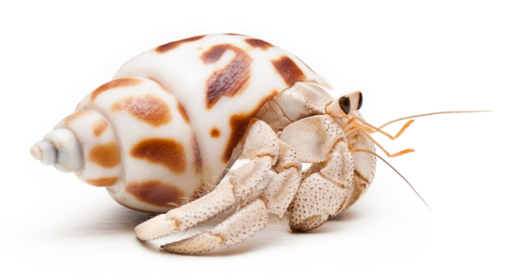
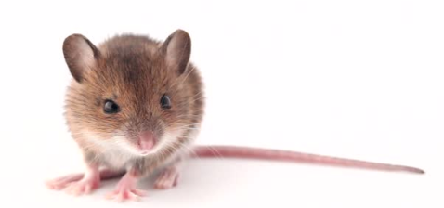
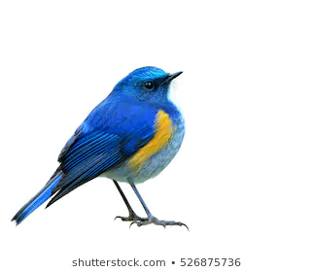
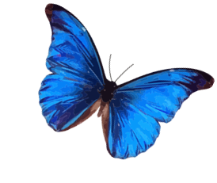
We will classify organisms using tabular keys.
CHECK FOR UNDERSTANDING
Use the table below to identify: Mouse - Bird - Butterfly - Hermit Crab
Use the dichotomous key below to create a tabular key.
Shell
No shell
1
1 | Shell No Shell | ________ Go To 2
2 | F_______________________ N______________________ | ________ Go To 3
3 | F_______________________ N______________________ | ________ ________
Fur
No Fur
2
Feathers
No feathers
3
VOCABULARY
1 - long appendages on insect heads

Slide 19
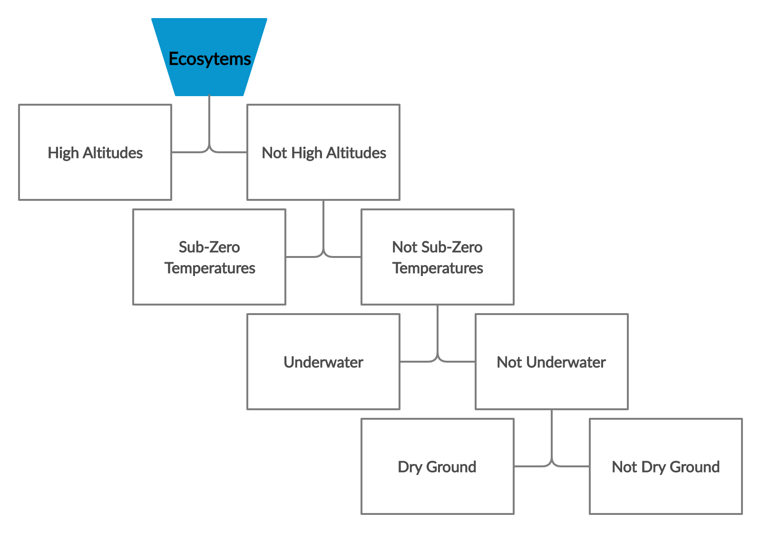
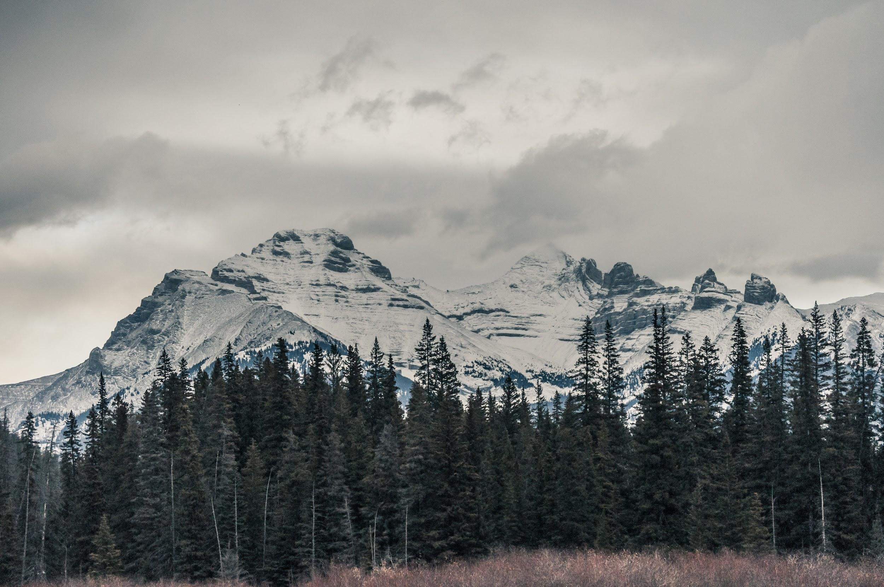
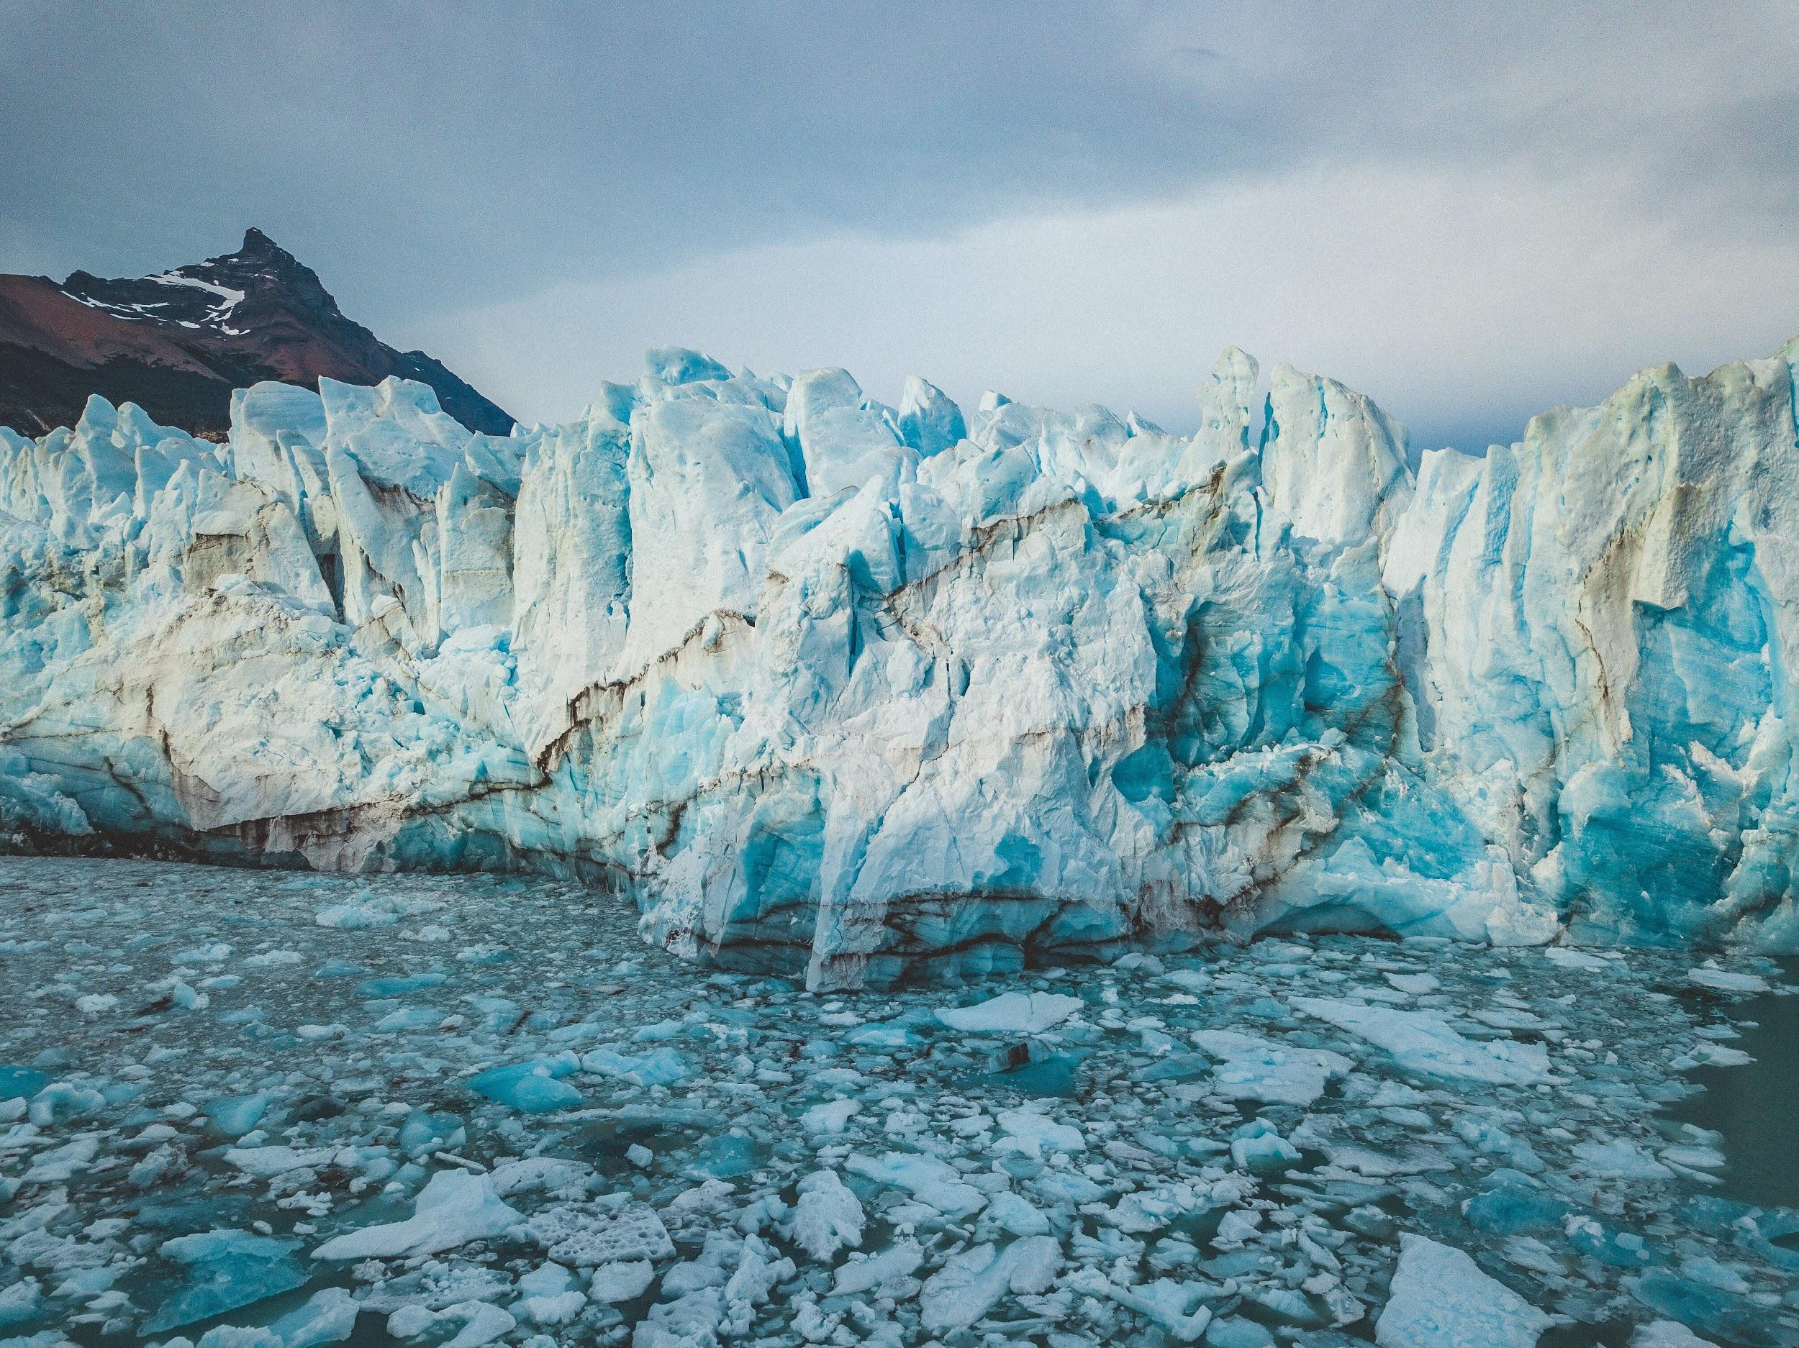
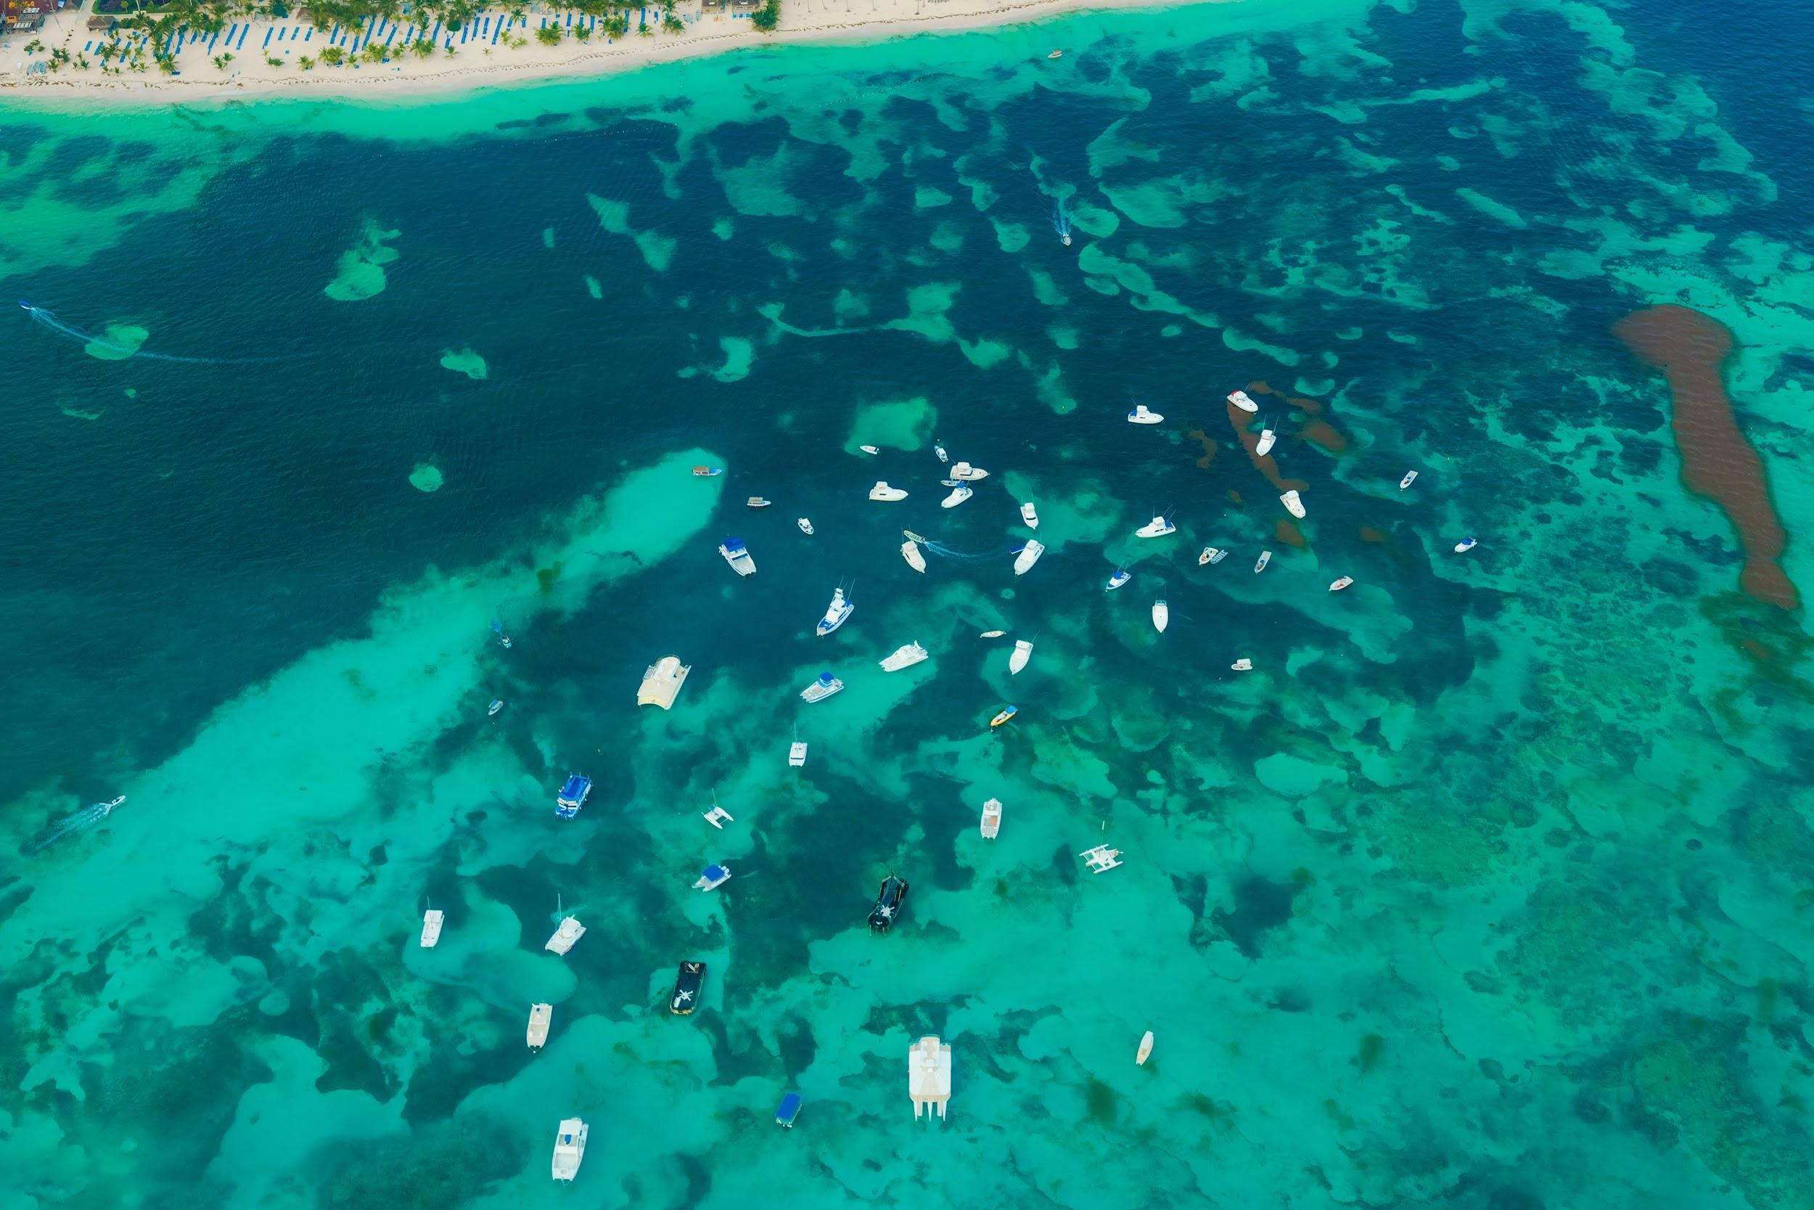

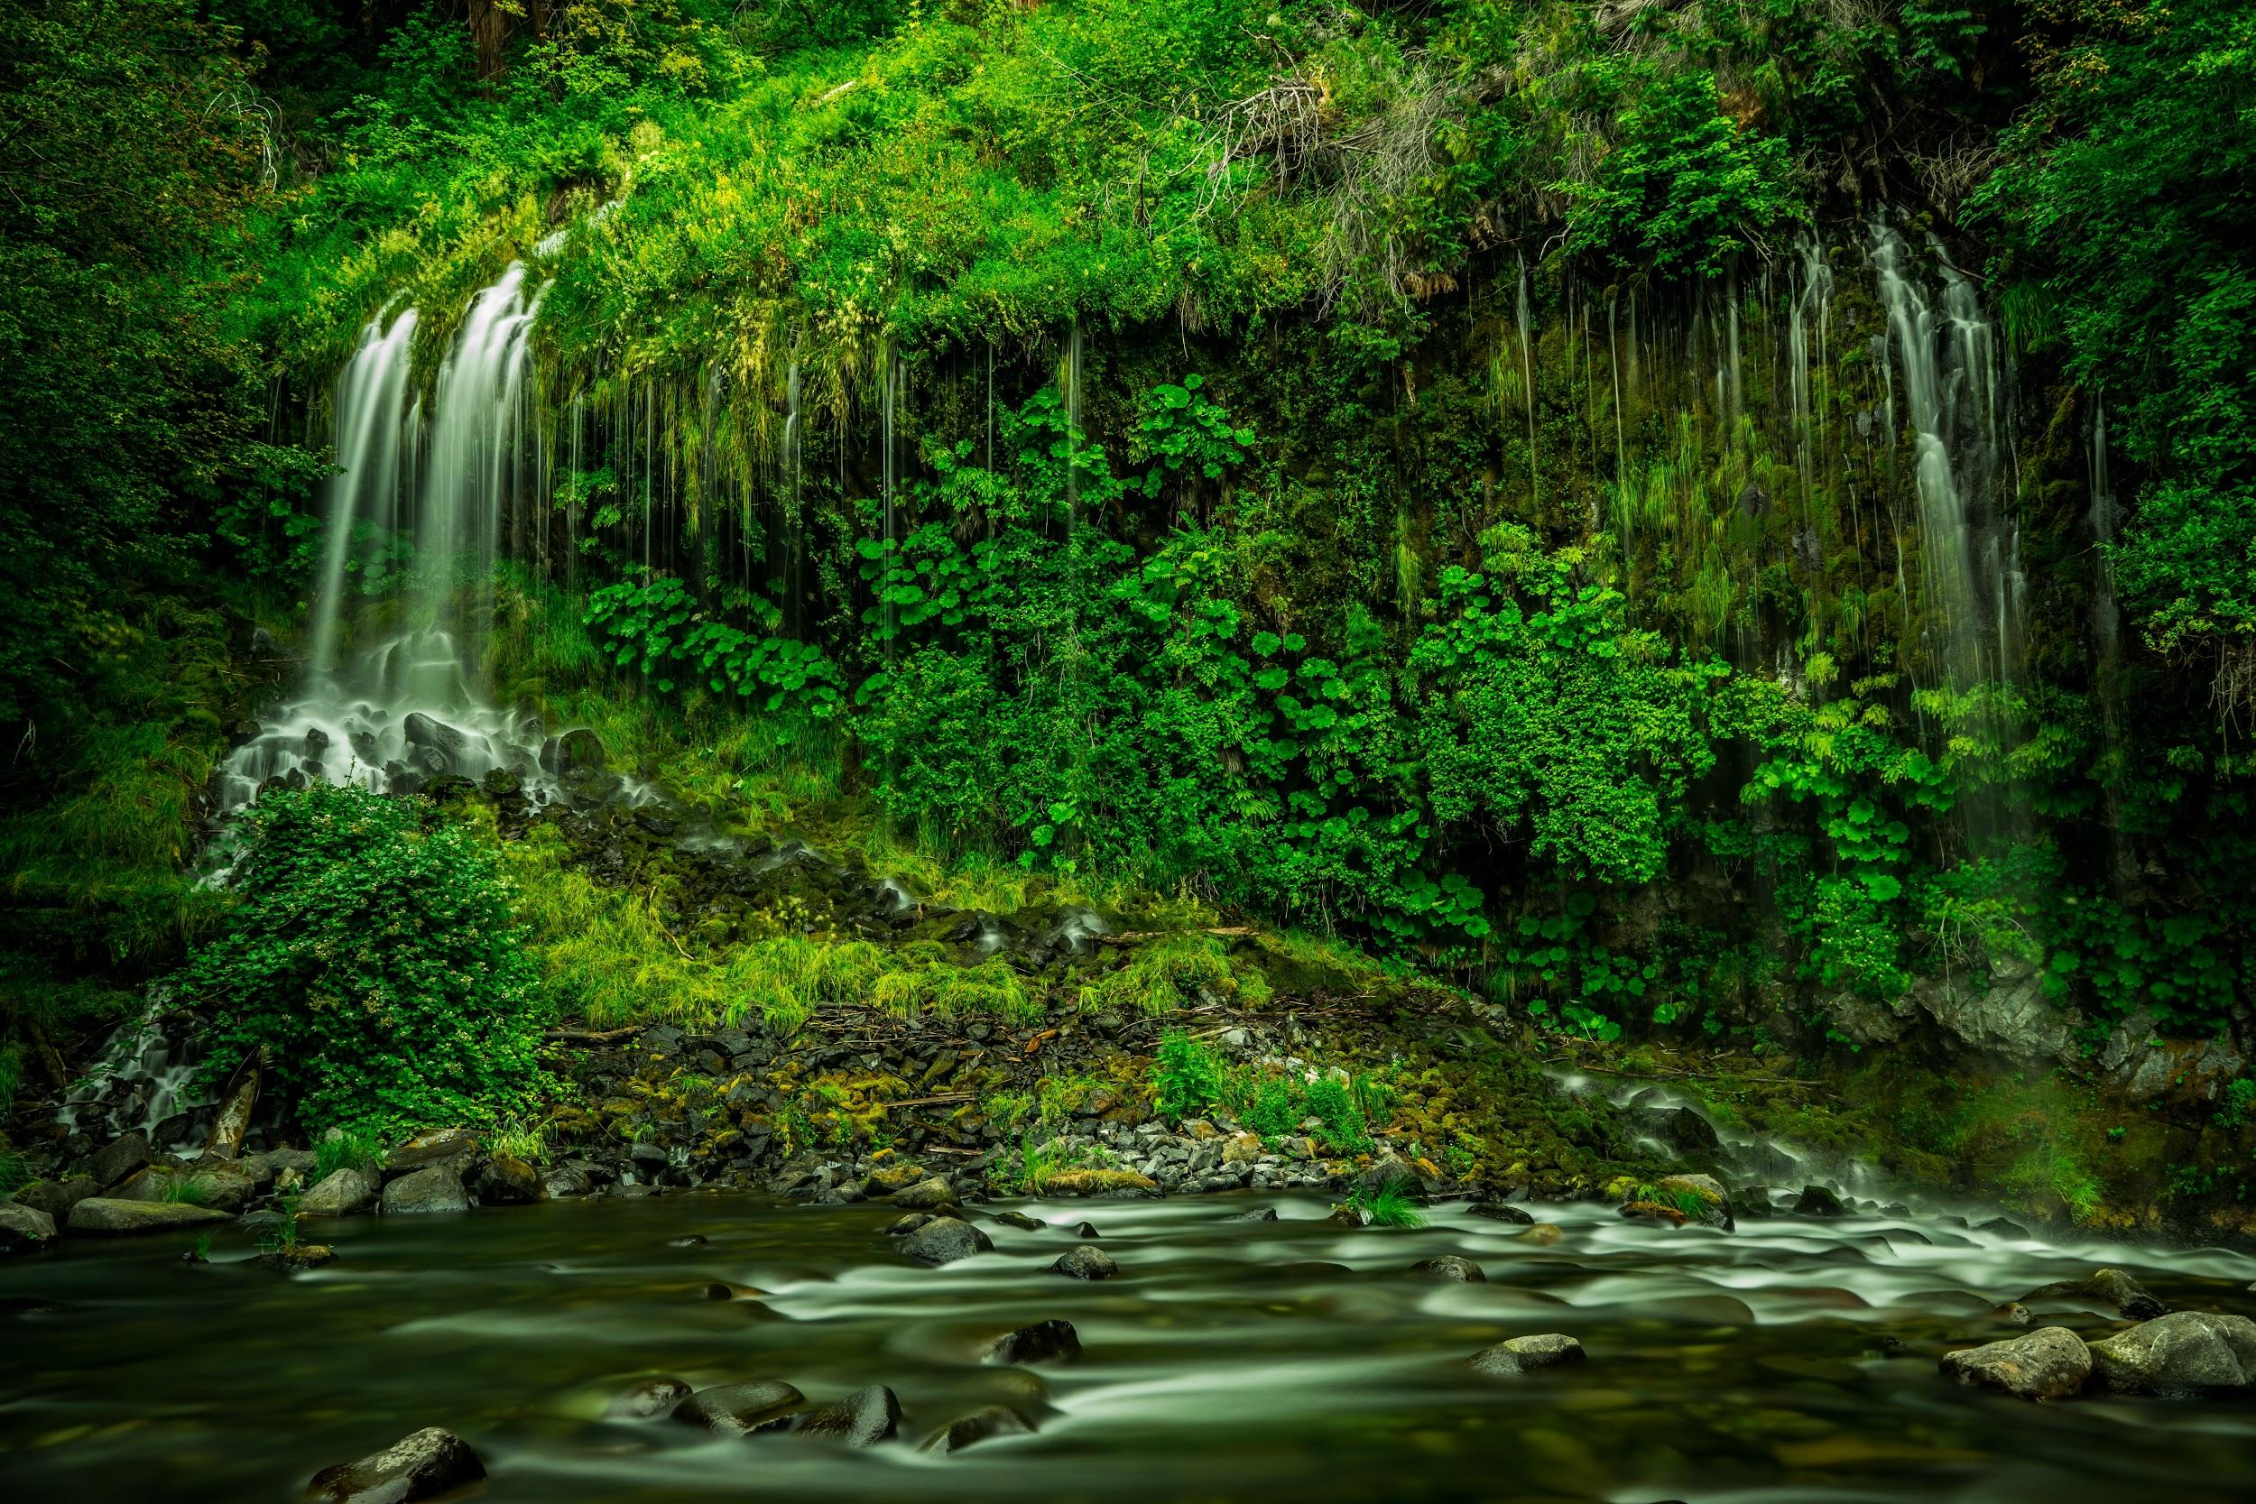
We will classify organisms using tabular keys.
CHECK FOR UNDERSTANDING
Use the table to identify: Mountains - Reefs - Ice Caps Rainforest - Desert
Use the dichotomous key below to create a tabular key.
HINT
A classification system or key separates organisms based off key physical features. These features are identified with simple yes or no answers (e.g. Has Shell or Does Not Have Shell). A dichotomous key separates organisms into two groups until each organism is identified. A tabular key separates organisms by prompting responses to identify a species.

Slide 20
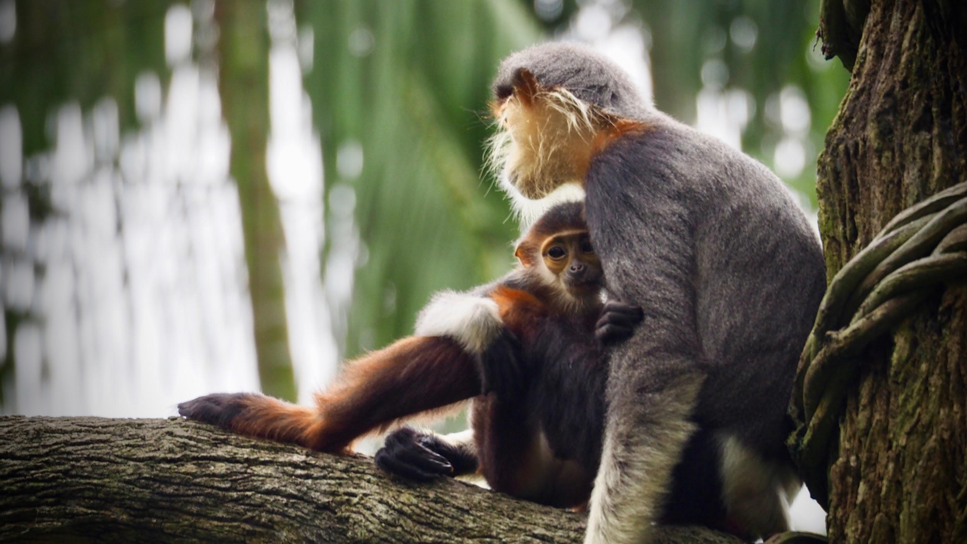

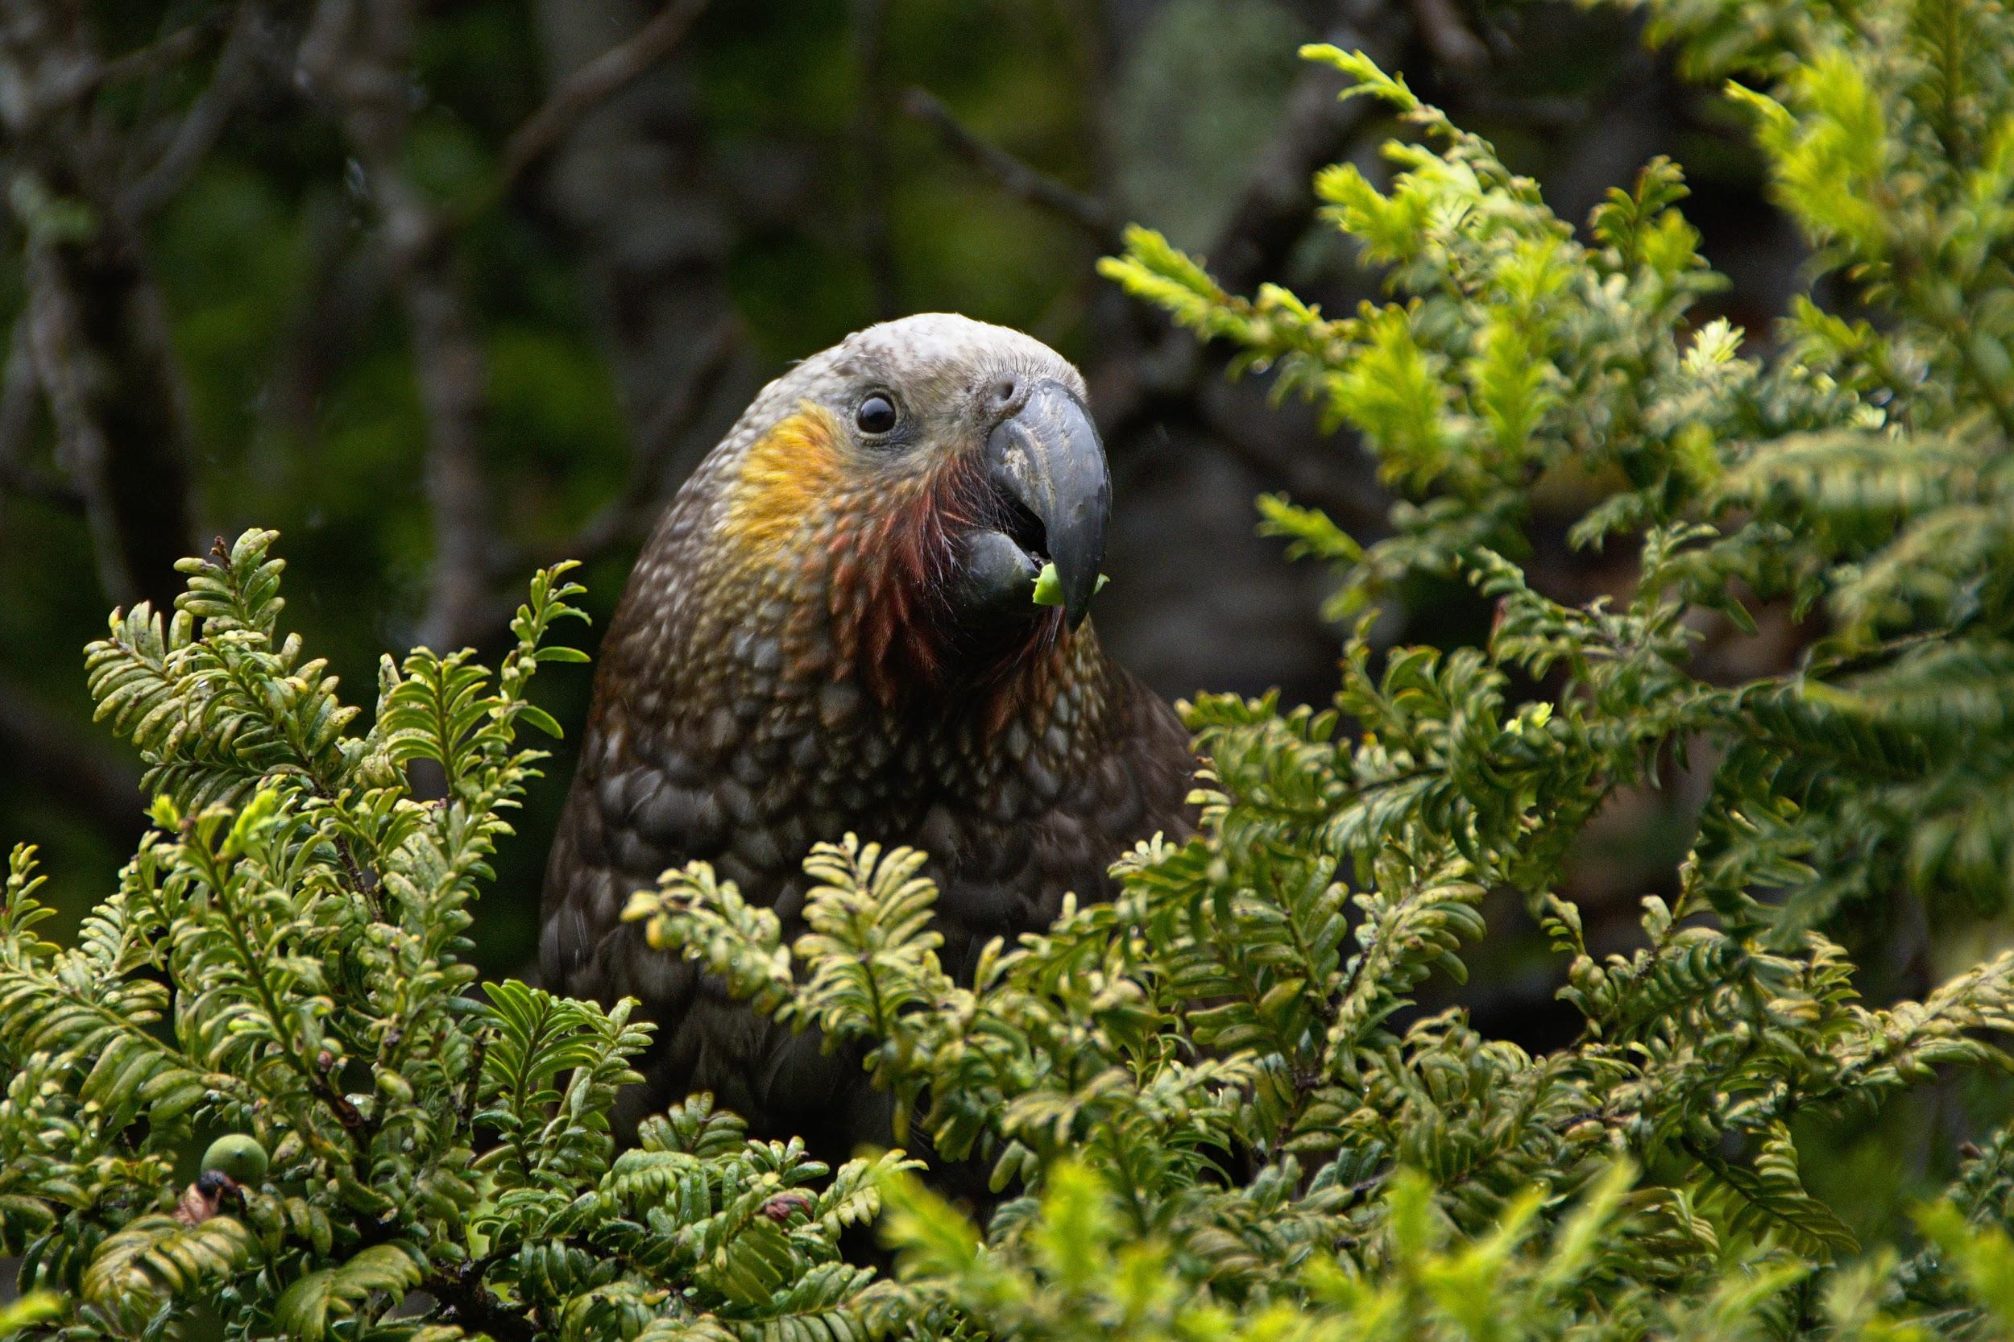
We will classify organisms using tabular keys.
MAKE THE CONNECTION
Students, you already know about domesticated animals such as cats, dogs, birds and fish. You also know of a number of different wild creatures such as lions, apes, wolves and whales.
There a over 9 billion different species of animals and plants.
With so many different variations of similar living organisms, scientists have created a number of different systems to classify them.
How many different types of animals can you list?
EXTENSION
What are some of the similarities and differences of these creatures.

Slide 21
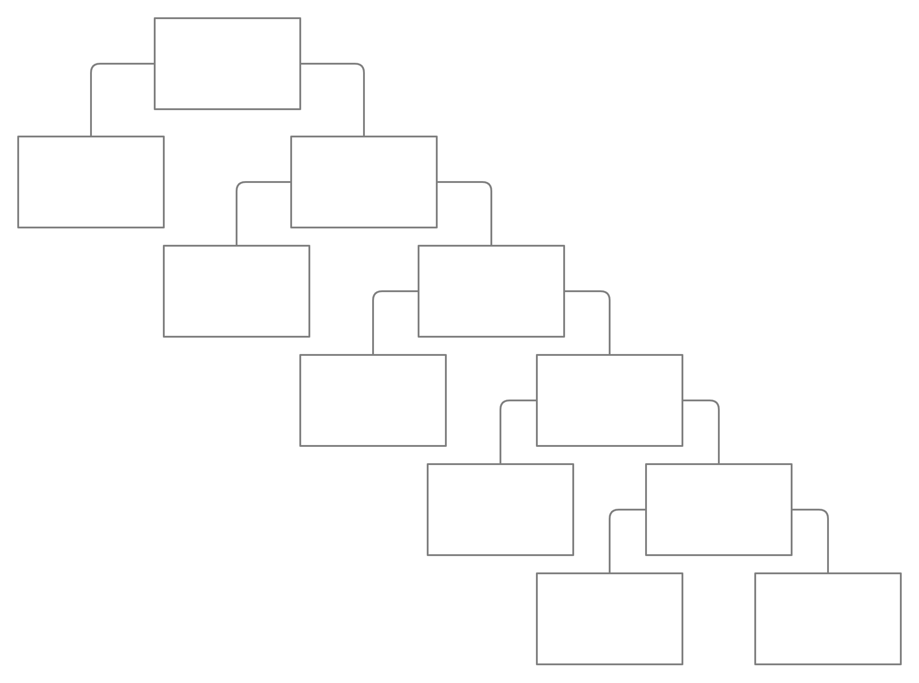
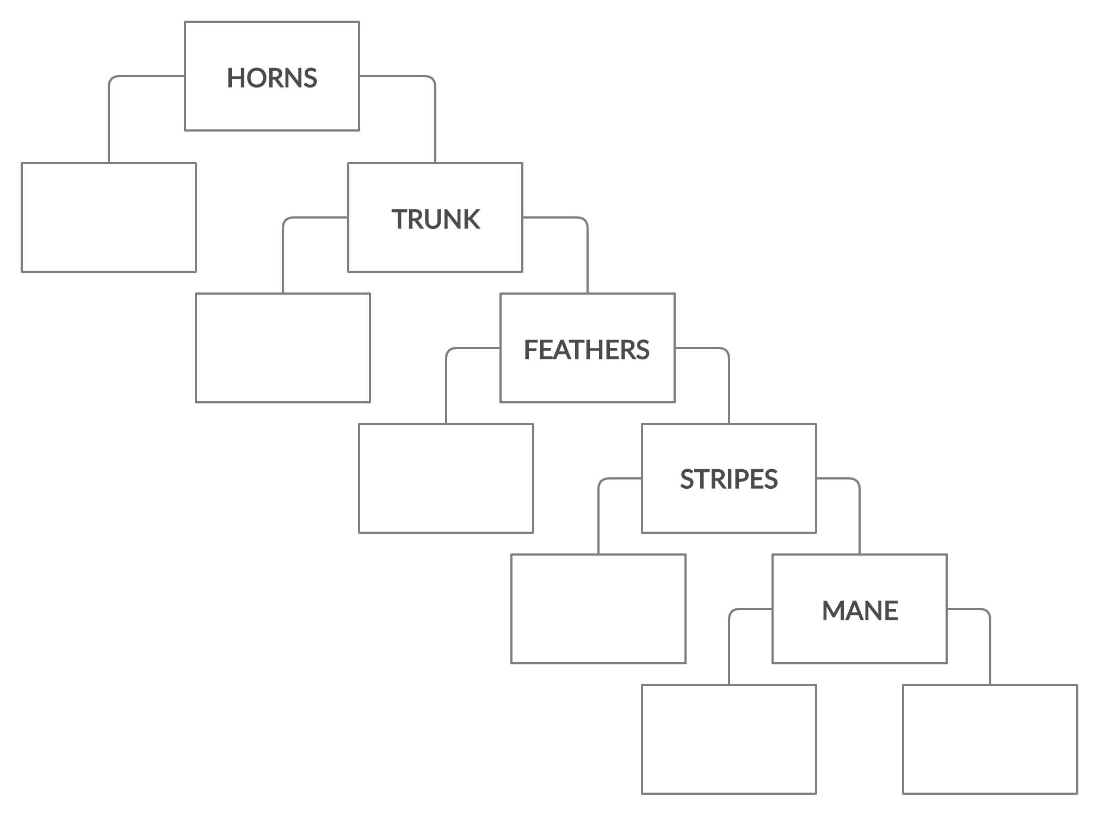
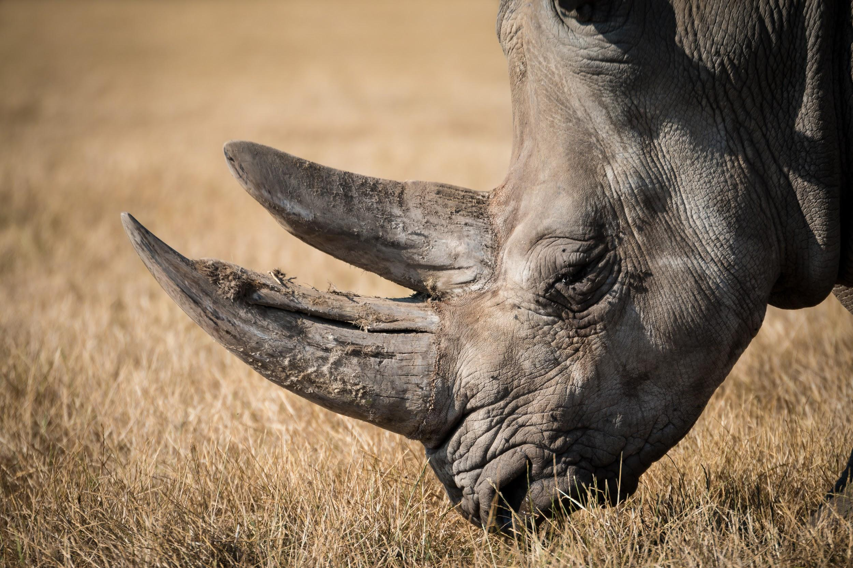
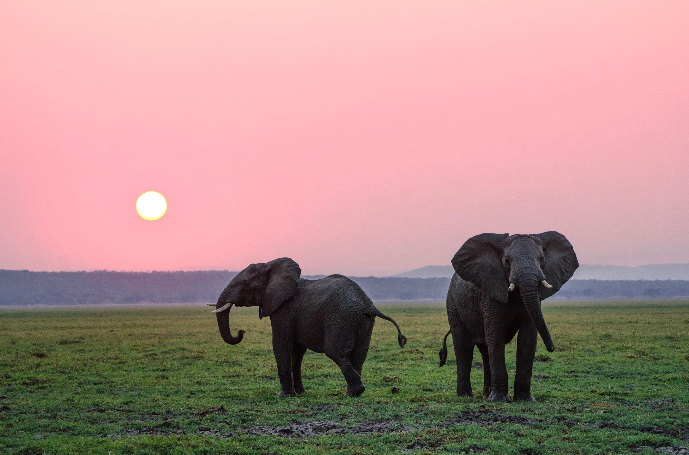
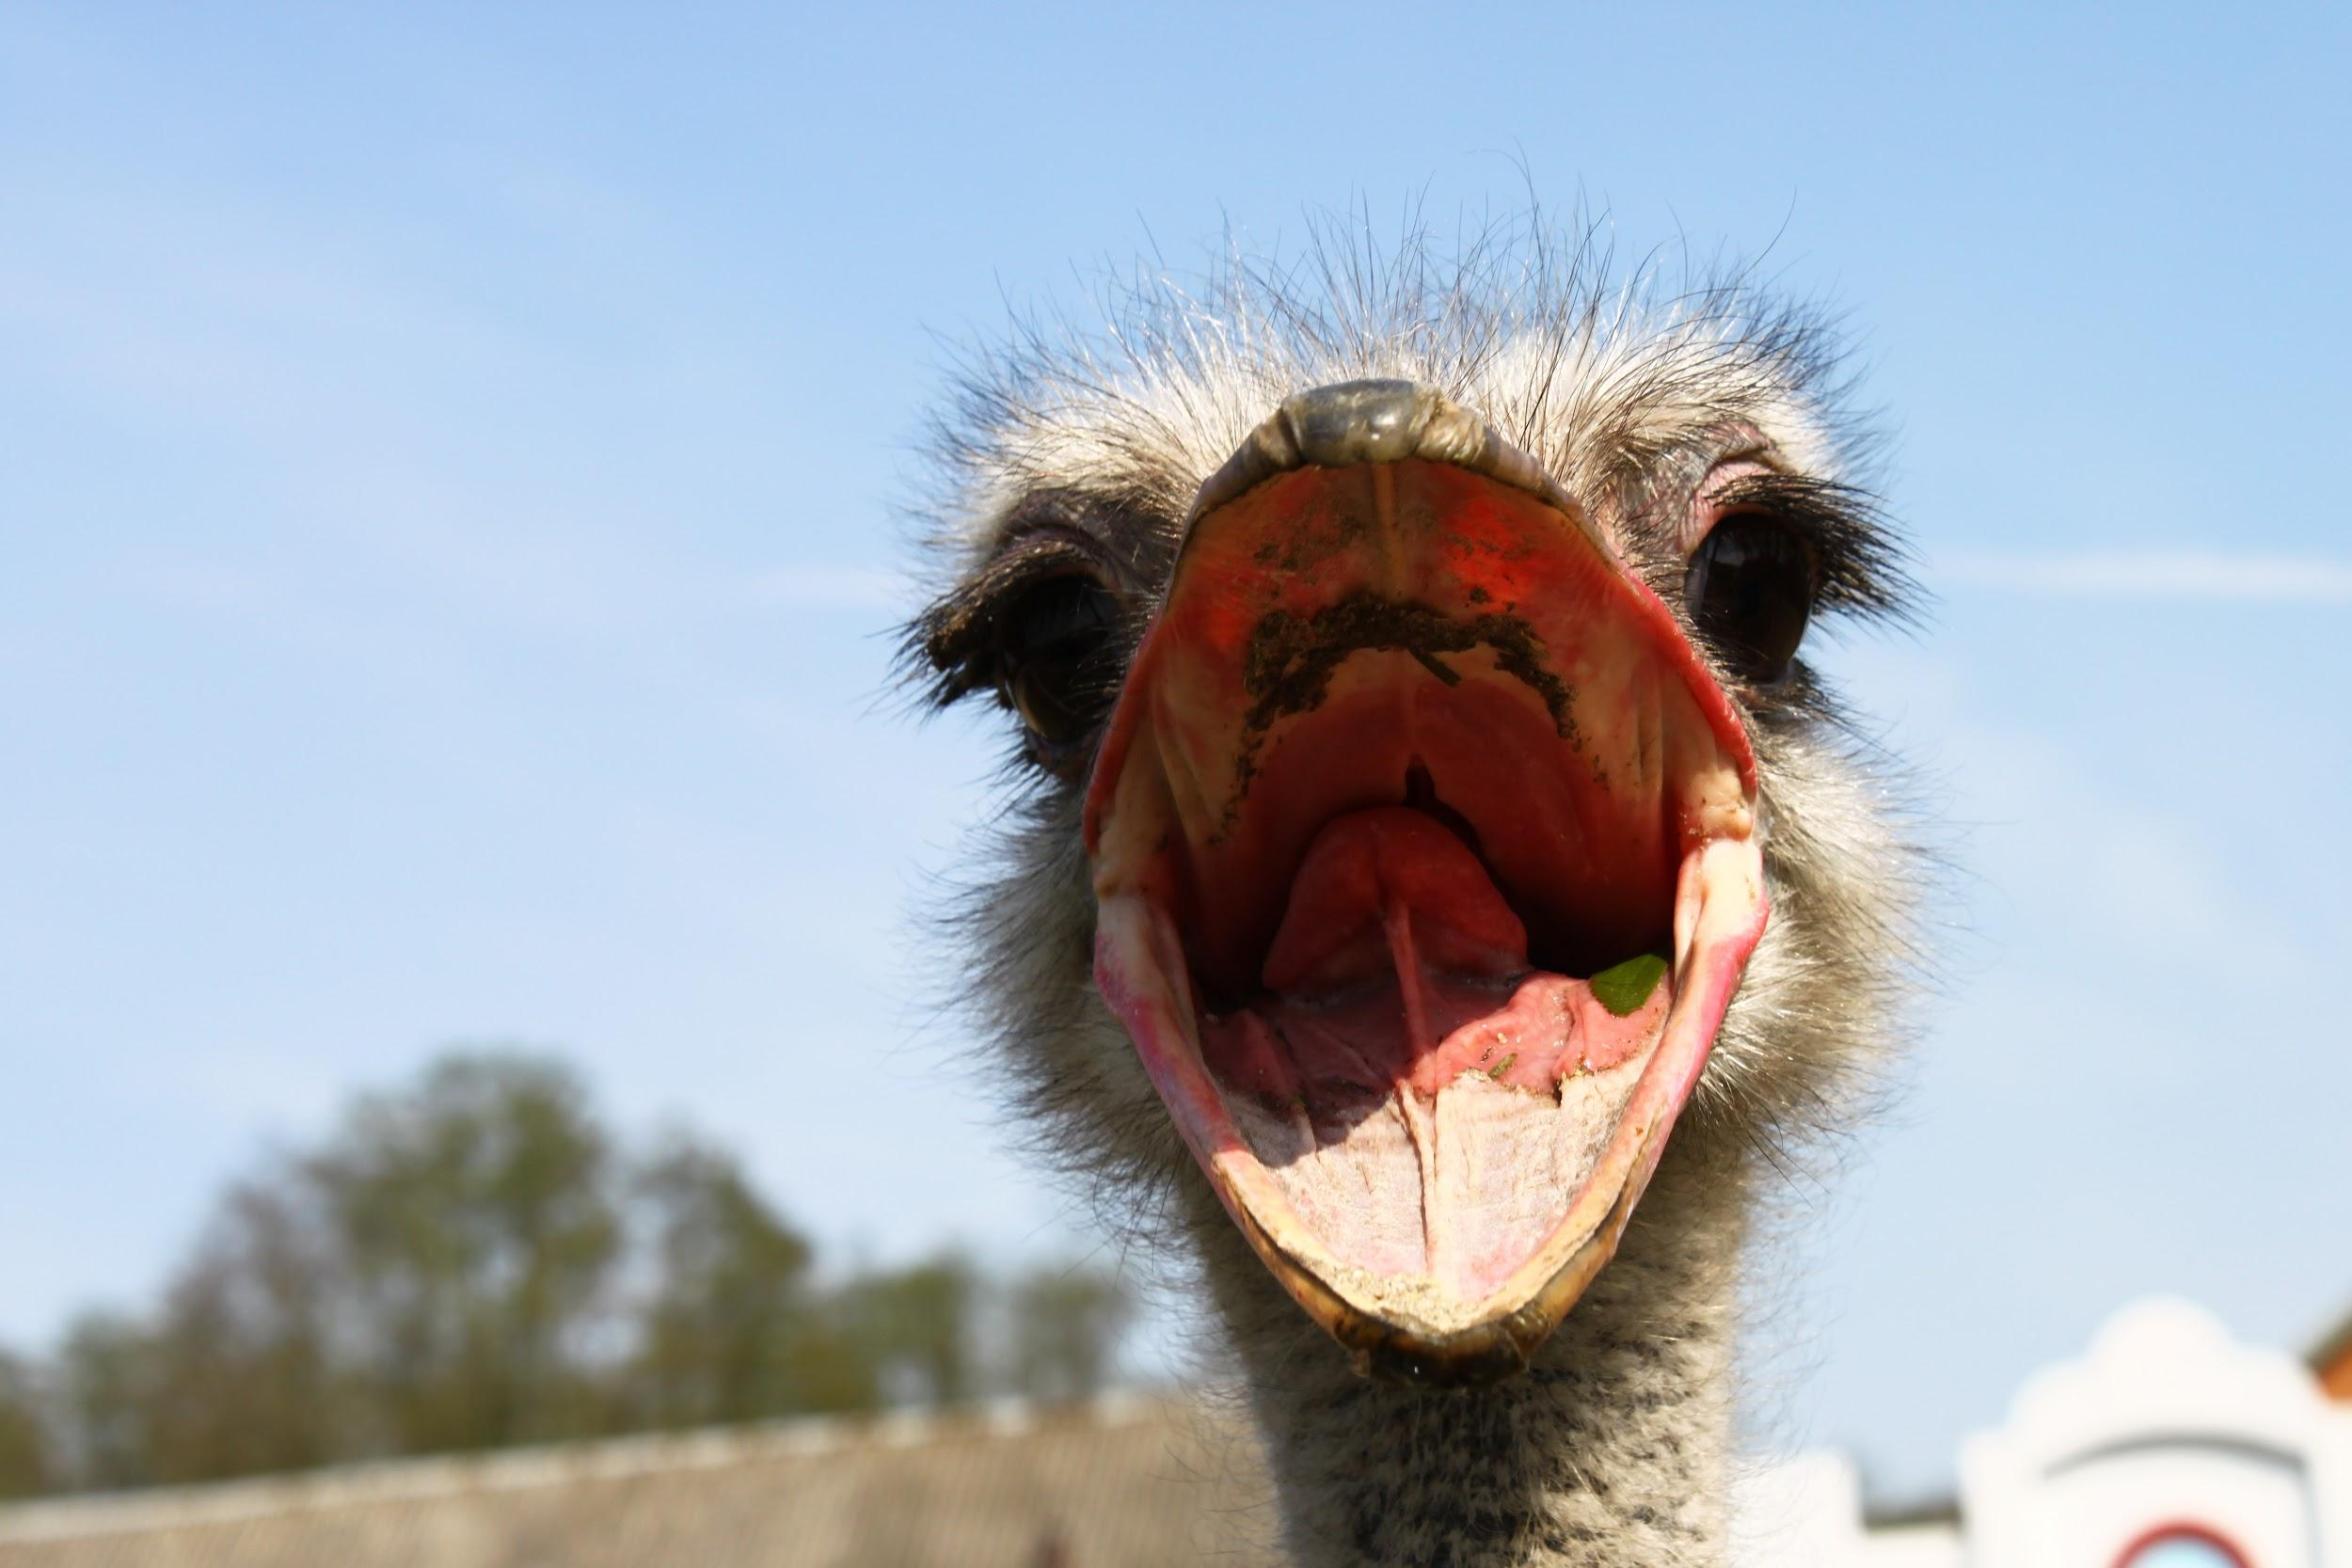
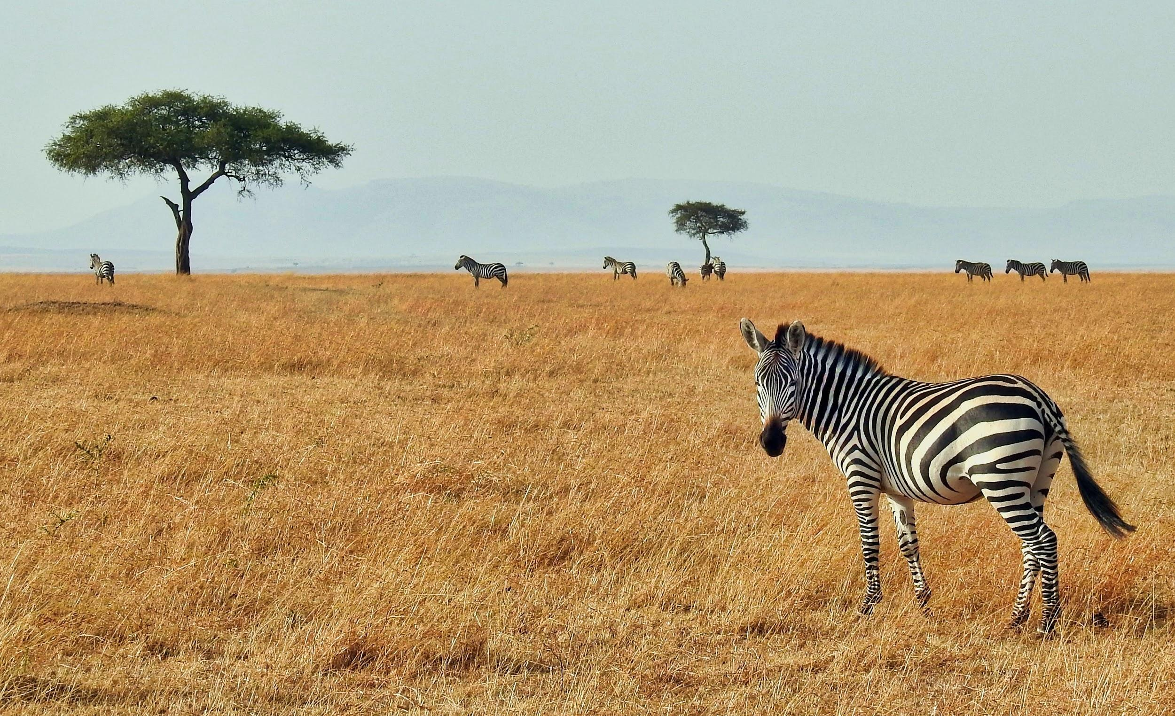
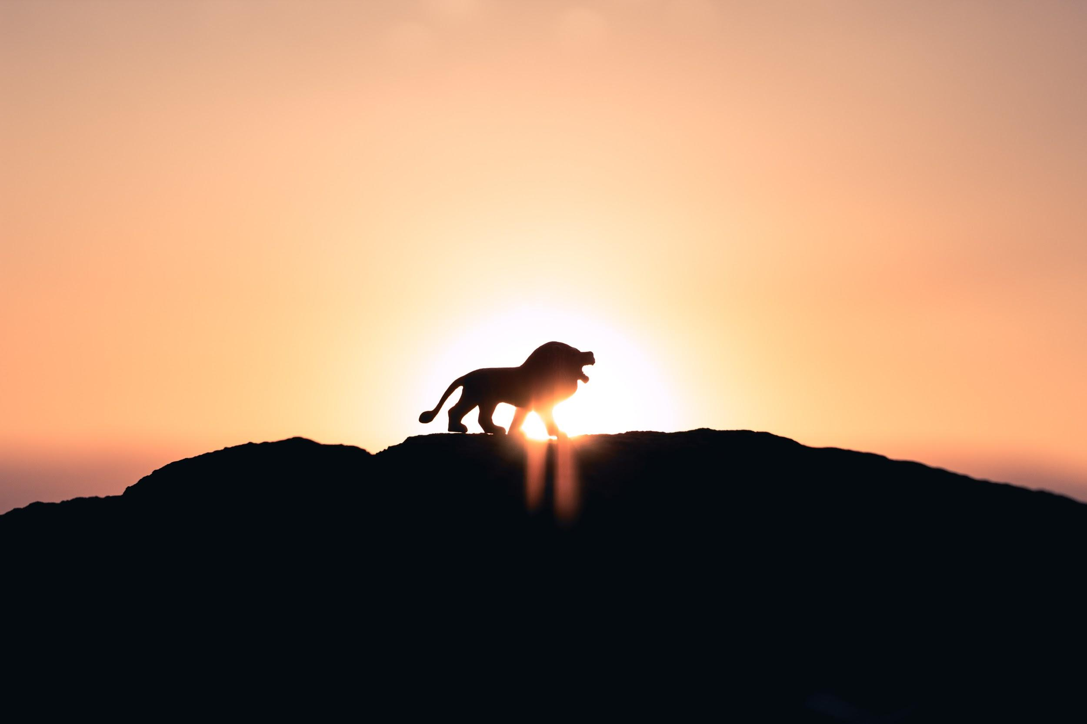
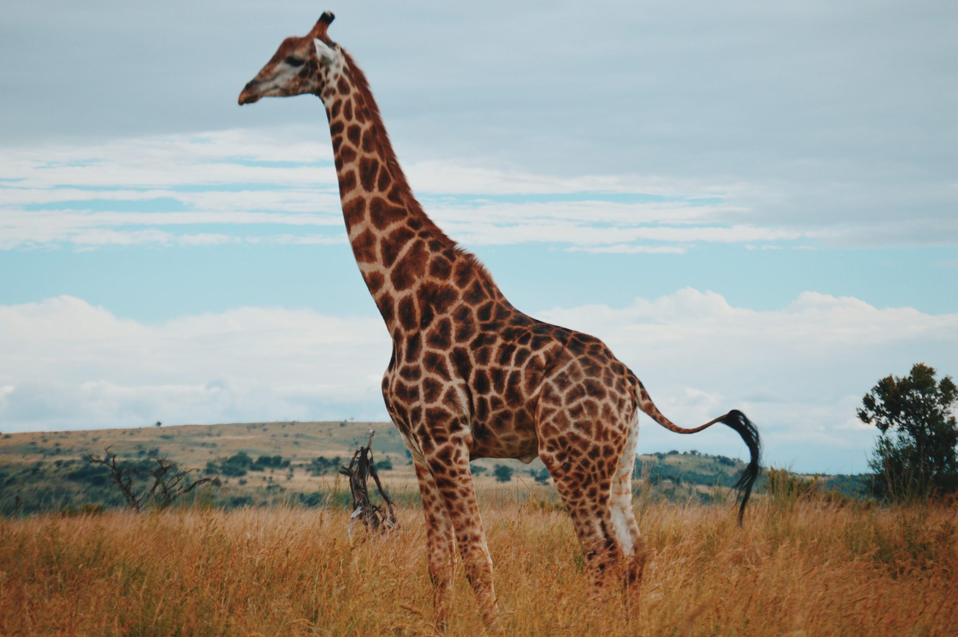
We will classify organisms using tabular keys.
CHECK FOR UNDERSTANDING
Complete the table below:
Animals On Safari
1 | Has Horns Has No Horns | Rhino Go To 2
2 | Has Trunk Has No _______ | ________ ________
3 | Has __________ Has No _______ | ________ Go to 4
4 | Has __________ Has No _______ | ________ Go to 5
5 | Has A ________ Has No _______ | ________ ________
Rhinoceros
Elephant
Ostrich
If YES move ←
If NO move →
Zebra
Lion
Giraffe

Slide 22






We will classify organisms using tabular keys.
CHECK FOR UNDERSTANDING
Complete the table below:
Animals On Safari
1 | Has Horns Has No Horns | Rhino Go To 2
2 | Has Trunk Has No _______ | ________ ________
3 | Has __________ Has No _______ | ________ Go to 4
4 | Has __________ Has No _______ | ________ Go to 5
5 | Has A ________ Has No _______ | ________ ________
If YES move ←
If NO move →

Slide 23






We will classify organisms using tabular keys.
CHECK FOR UNDERSTANDING
Why do we use classification systems? Please explain.
Create a dichotomous key for these organisms.
Create a tabular key for these organisms.
HINT
Students, remember that we use keys to help classify different organisms based on their features. A classification system or key separates organisms based off key physical features. These features are identified with simple yes or no answers (e.g. Has Shell or Does Not Have Shell). A dichotomous key separates organisms into two groups until each organism is identified. A tabular key separates organisms by prompting responses to identify a species.
1 | Has _______ Has No ____
2 | Has _______ Has No ____
3 | Has _______ Has No ____
Notes:
Please include tasks/questions here rather than just referring to a worksheet. This will save on photocopying and facilitate sharing with other schools.
Try and build tasks/questions which escalate through Bloom’s Taxonomy. This will help with differentiation.

Slide 24






CHECK FOR UNDERSTANDING
Why do we use classification systems? Please explain.
We will classify organisms using tabular keys.
Create a dichotomous key for these organisms.
Create a tabular key for these organisms.
MAKE THE CONNECTION
Students, remember that we use keys to help classify different organisms based on their features. A classification system or key separates organisms based off key physical features. These features are identified with simple yes or no answers (e.g. Has Shell or Does Not Have Shell). A dichotomous key separates organisms into two groups until each organism is identified. A tabular key separates organisms by prompting responses to identify a species.
Seahorse
Clown Fish
HINT
Key features you could mention include: Has A Shell Has A Snout Has Fins Has a barb on tail Has White Stripes Has Gills
Tiger Shark
Stingray
Turtle
Starfish
Notes:
These organisms are too similar and require specialist knowledge or in depth knowledge of the organisms to separate them. Can’t just easily separate based on what you can observe.

Slide 25



CHECK FOR UNDERSTANDING
Why do we use classification systems? Please explain.
We will classify organisms using tabular keys.
Create a dichotomous key for these organisms.
Create a tabular key for these organisms.
MAKE THE CONNECTION
Students, remember that we use keys to help classify different organisms based on their features. A classification system or key separates organisms based off key physical features. These features are identified with simple yes or no answers (e.g. Has Shell or Does Not Have Shell). A dichotomous key separates organisms into two groups until each organism is identified. A tabular key separates organisms by prompting responses to identify a species.
Crab
HINT
Key features you could mention include: Has a shell Has fins Has gills Has antennae Has claws Has tentacles
Cuttle Fish
Tiger Shark
Sea slug
Turtle
Starfish
Notes:
These organisms are too similar and require specialist knowledge or in depth knowledge to separate them. Can’t just easily separate based on what you can observe.

Slide 26




We will classify organisms using tabular keys.
EXTENSION
In your groups, create a tabular key to identify each other.
Create a tabular key for these organisms.
MAKE THE CONNECTION
A classification system or key separates organisms based off key physical features. These features are identified with simple yes or no answers (e.g. Has Shell or Does Not Have Shell). A dichotomous key separates organisms into two groups until each organism is identified. A tabular key separates organisms by prompting responses to identify a species.
Oak
Palm
Pine
Mangrove
Notes:
Extension task?

Slide 27
We will classify organisms using tabular keys.
We will define tabular.
We will use provided tabular keys to classify organisms,
We will construct tabular keys.
CHECK FOR UNDERSTANDING
Check Success Criteria.

Slide 28
We will classify organisms using tabular keys.
CHECK FOR UNDERSTANDING
Complete the table below:
1 | Has Horns Has No Horns | Go to 2 Go To 3
2 | Has Trunk Has No _______ | ________ ________
3 | Has __________ Has No _______ | ________ Go to 4
4 | Has __________ Has No _______ | ________ Go to 5
5 | Has A ________ Has No _______ | ________ ________
Animals On Safari
Rhinoceros
Elephant
Ostrich
If YES move ←
If NO move →
Zebra
VOCABULARY
Lion
Giraffe

